Slide 1
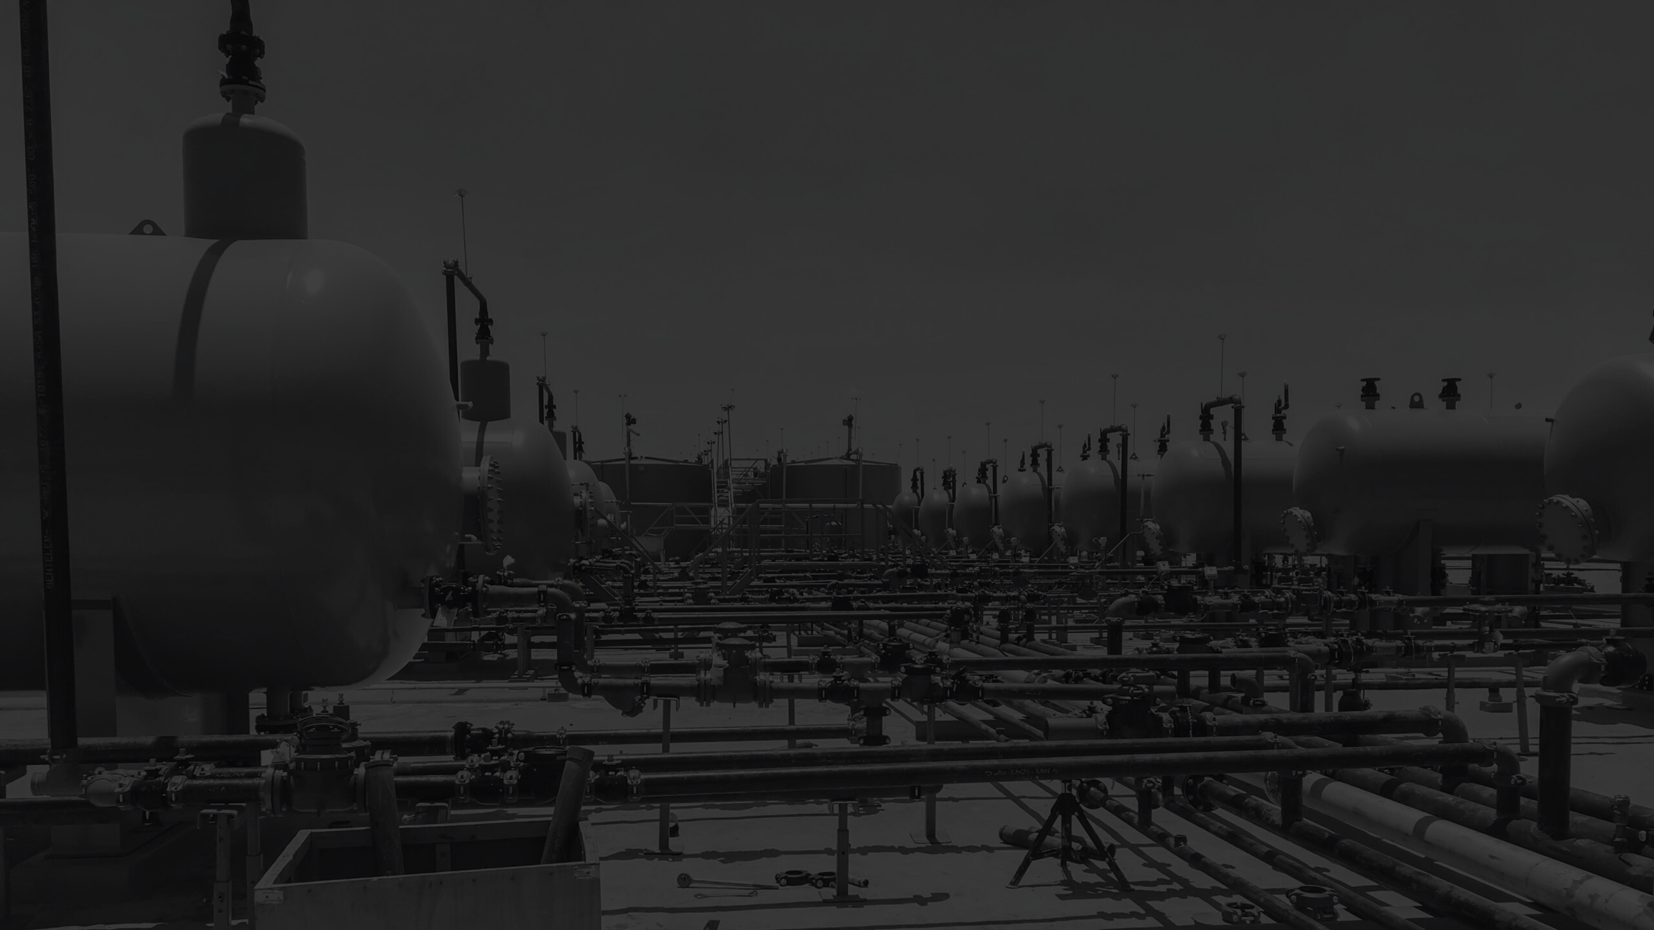

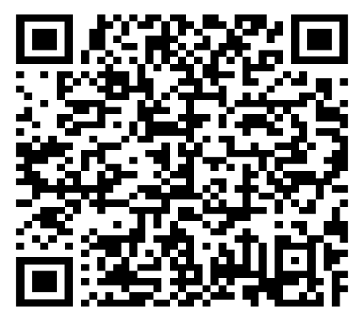
Q3 2025
Contractor Safety Meeting
Scan the QR code to sign-in.
Welcome!
We will begin shortly!

Slide 2
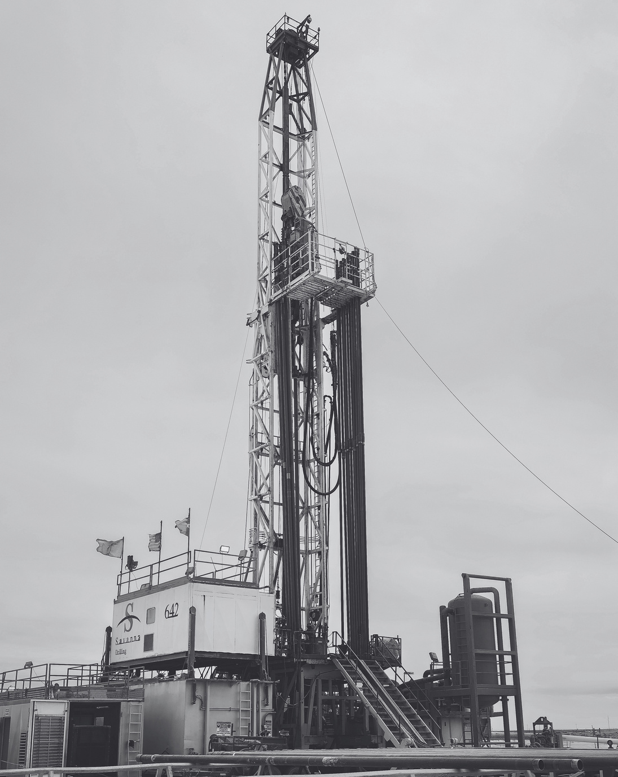

MEETING PROTOCOLS
In Case of an Emergency:
  Jonathan Conners Petroleum Museum Director of Rentals
  Exits & Muster Points
Please put phones on vibrate. If you need to take a call, please step outside.
Restrooms are to your right and out through the double doors.
We ask that you participate in the discussion!

Slide 3
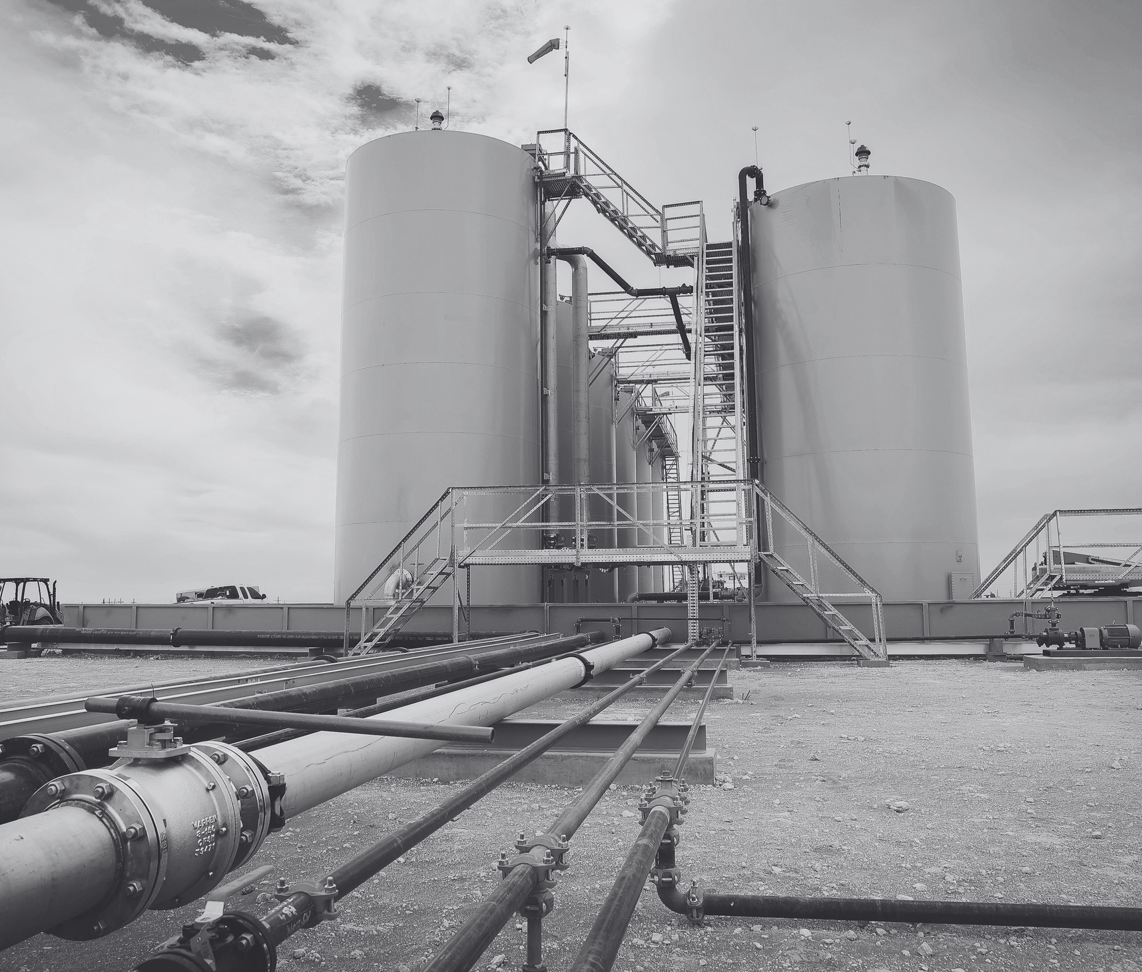
AGENDA
Welcome & Introductions
Safety Moment – Jim Brooks
EnXL Safety Meeting Topics:
  Vehicle and Mobile Equipment Safety–Strugeon
  Electrical Arc Flash – Big G Electric
Safety Statistics – Frank Savage
CEO Comments - Bruce Johnson
Conclusion

Slide 4

QR Code to Sign-in
Select Meeting: Drop Down –
Everything else is your information – Please fill out completely.
Please sign and submit
The information will also be used for our drawings.

Slide 5
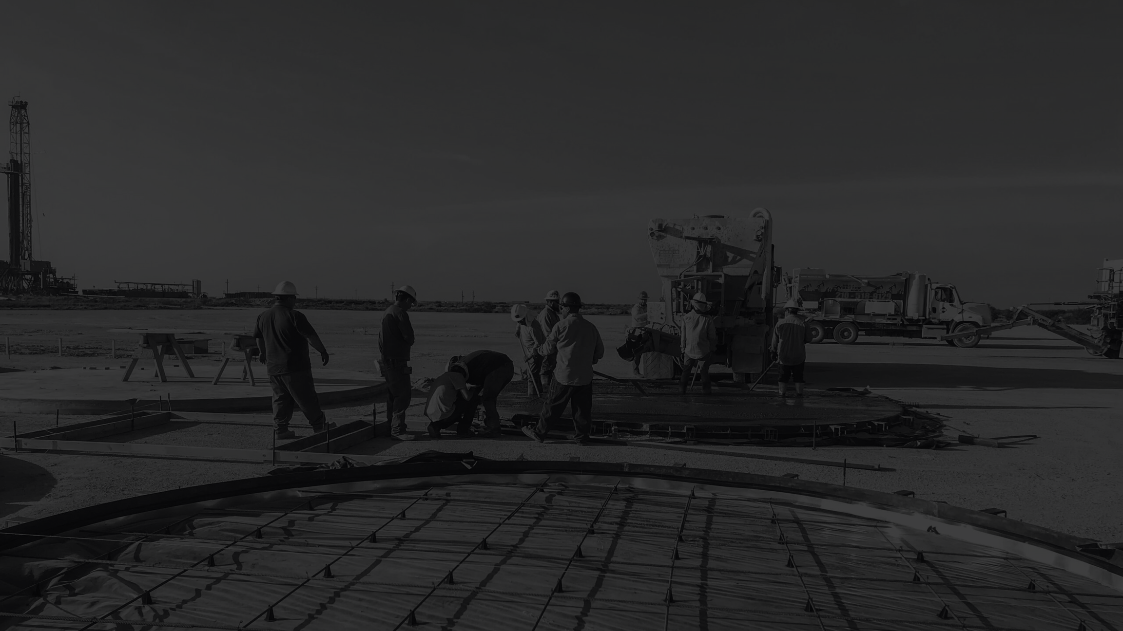
SAFETY MOMENT
Jim Brooks

Slide 6
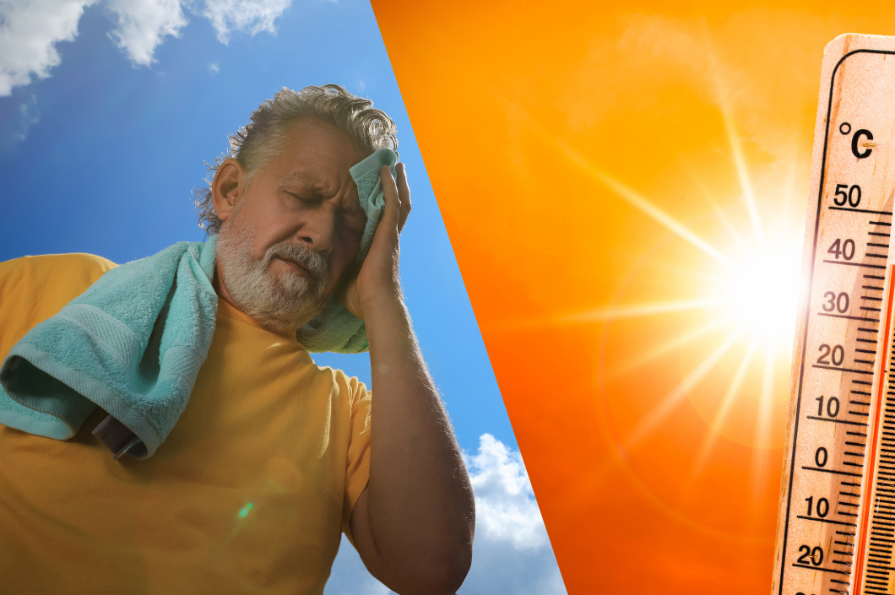
Your Skin and the Sun

Slide 7
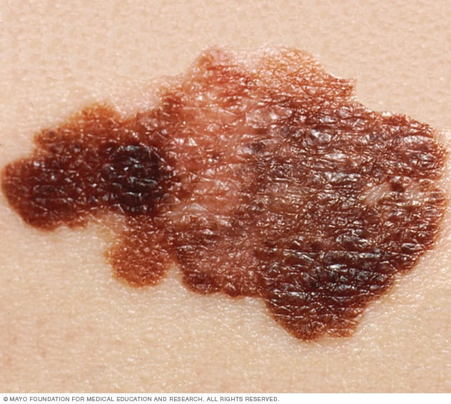
Your Skin and The Sun
Skin cancer is cancer that starts as a growth of cells on the skin. The cells can invade and destroy healthy body tissue. Sometimes the cells break away and spread to other parts of the body.
Many kinds of skin cancer exist. The most common skin cancers are basal cell carcinoma and squamous cell carcinoma. While these are the most common, they often can be cured. The most dangerous form of skin cancer is melanoma. It is more likely to spread, making it harder to cure.
Most skin cancers happen on skin that gets a lot of sunlight. The light that comes from the sun is thought to cause most skin cancers. You can reduce your risk of skin cancer by covering your skin with clothes or sunscreen to protect it from the sun.
Melanoma
The first sign of melanoma is often a mole that changes size, shape or color. This melanoma shows color variations and an irregular border, both of which are melanoma warning signs.

Slide 8
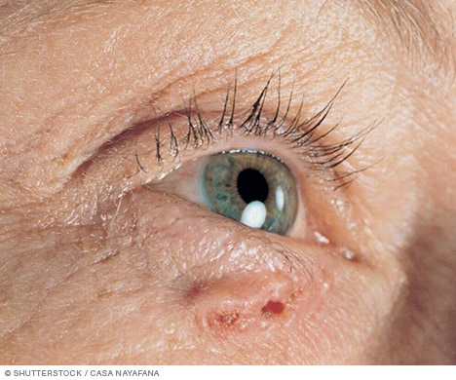
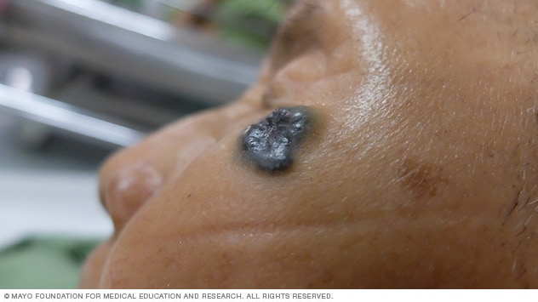
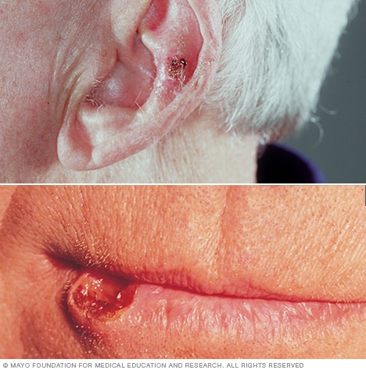
Your Skin and The Sun
Some skin cancers happen on skin that doesn't typically get sun. This likely means that something else is causing these cancers. To reduce your risk of these kinds of skin cancers, check your skin regularly for any changes. Report these changes to your healthcare professional.
What skin cancer looks like
Basal cell carcinoma on white skin
Basal cell carcinoma is a type of skin cancer that most often develops on areas of skin exposed to the sun, such as the face. On white skin, basal cell carcinoma often looks like a bump that's skin-colored or pink.
Basal cell carcinoma on brown skin
Basal cell carcinoma is a type of skin cancer that most often develops on areas of skin exposed to the sun, such as the face. On brown and Black skin, basal cell carcinoma often looks like a bump that's brown or glossy black and has a rolled border.
Squamous cell carcinoma of the skin
Sun-exposed areas such as the lower lip and ears are most likely to develop squamous cell carcinoma of the skin.

Slide 9
Your Skin and The Sun
Signs and symptoms of skin cancer include:
A new growth on the skin that might look like a mole, a bump or a scab.
A rough patch on the skin.
A sore on the skin that won't heal.
Changes to a mole or freckle, such as getting bigger or changing color.
Itchy skin around a skin growth.
Pain around a skin growth.

Slide 10
Your Skin and The Sun
Where skin cancer happens
Most skin cancers happen on parts of the body that get a lot of sun. This includes the scalp, face, lips and ears. Other parts of the body that might get sun include the arms, backs of the hands, back and legs.
Skin cancer also can happen on skin that typically doesn't get sun. This includes the palms of the hands, the genitals, and under the fingernails and toenails. When skin cancer happens in people with Black or brown skin, it tends to happen in these places that don't typically get sun.
When to see a doctor
Make an appointment with a doctor or other healthcare professional if you notice any changes to your skin that worry you.

Slide 11

Your Skin and The Sun
Are there any other health issues related to UV radiation?
In addition to skin cancer, exposure to UV rays can cause other health problems:
Sunburn due to damage from UV rays from the sun and indoor tanning devices
Skin damage that leads to premature aging of the skin and signs of sun damage such as
wrinkles, leathery skin, liver spots, actinic keratosis, and solar elastosis.
Eye problems due to UV rays causing the cornea (on the front of the eye) become inflamed or burned. They can also lead to the formation of cataracts (clouding of the lens of the eye) and pterygium (tissue growth on the surface of the eye), both of which can impair vision.
Weakened immune system causing the body to have a harder time fending off infections. This can lead to problems such as reactivation of herpes triggered by exposure to the sun or other sources of UV rays. It can also cause vaccines to be less effective.
Certain medications can also make you more sensitive to UV radiation, making you more likely to get sunburned. And certain medical conditions can be made worse by UV radiation.

Slide 12
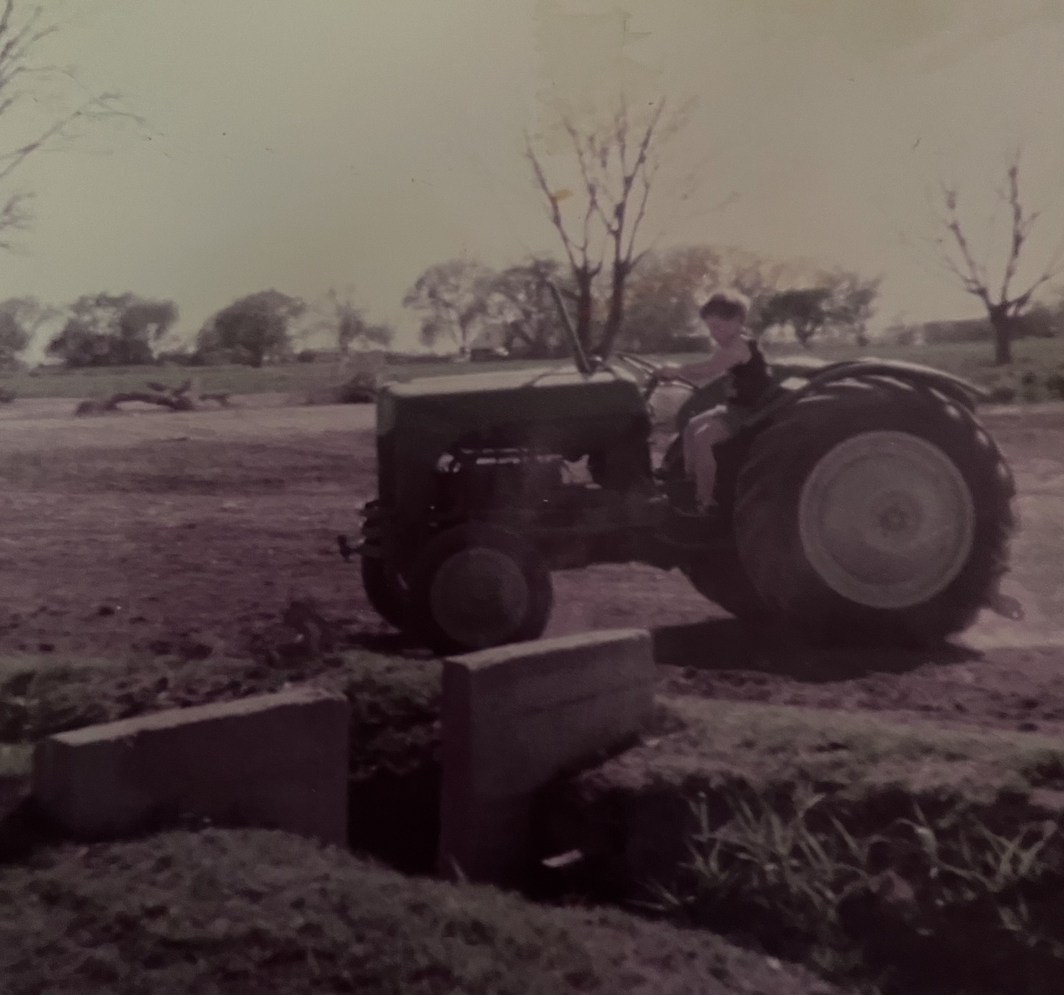
My Skin Cancer Story

Slide 13
?
ANY QUESTIONS
OR COMMENTS

Slide 14
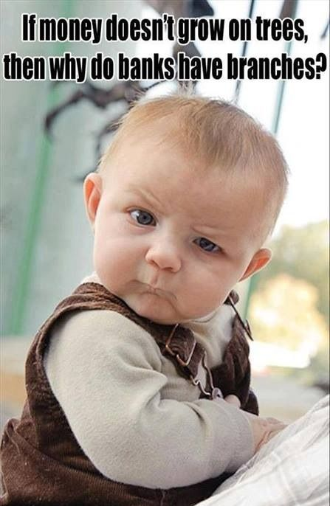
LET’S RAFFLE!

Slide 15

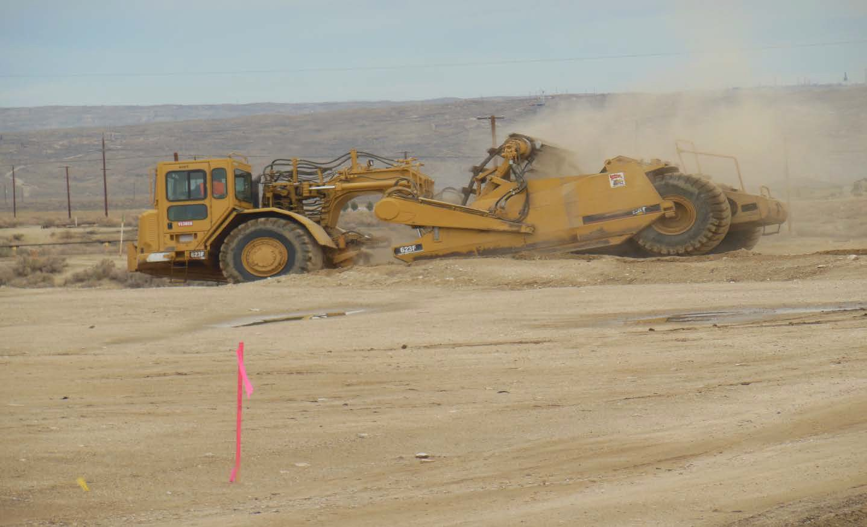
VEHICLE AND MOBILE EQUIPMENT SAFETY

Slide 16
VEHICLE AND MOBILE EQUIPMENT SAFETY

Slide 17

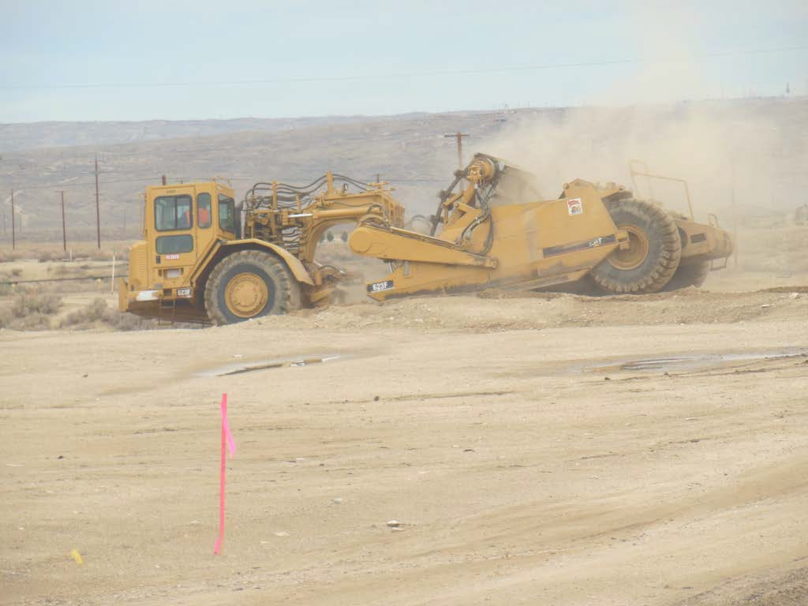
Vehicles/Mobile Equipment
Safety Concerns
Vehicles/Mobile Equipment present a wide array of varying sizes and shapes…and entailed within this variety, are serious blind spot safety concerns
You can check the blind spotswith the help of a teammate
Flagmen and co-workers should always maintain line of sight with the driver/operator
Learn to appreciate just how large these blind spot zones can be
Remember, much work is done bending down or squatting. This can drastically alter the visibility of the driver/operator
Noisy work environments can also hamper our ability to hear warning sounds such as reverse alarms on vehicles and mobile equipment.

Slide 18
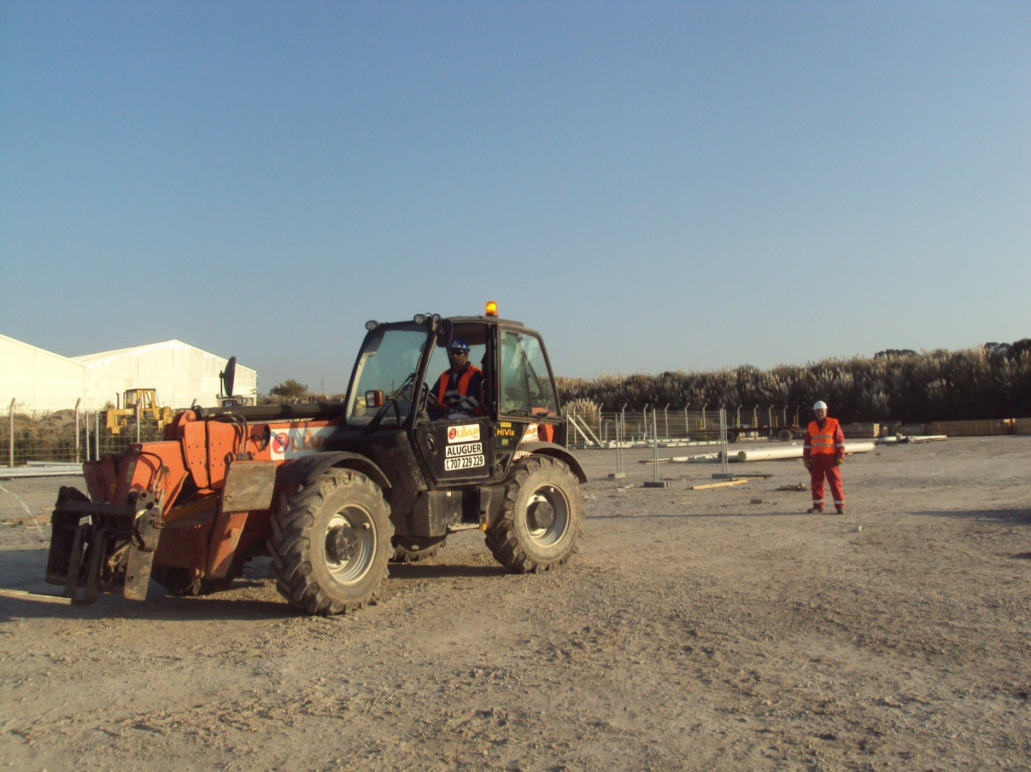
The “Blind Spot” is the vehicle/mobile equipment operator’s hindered view of pedestrian workers and stationery… the shaded areas on the following slides depict the driver/operator’s obscured view and the associated safety concerns.

Slide 19
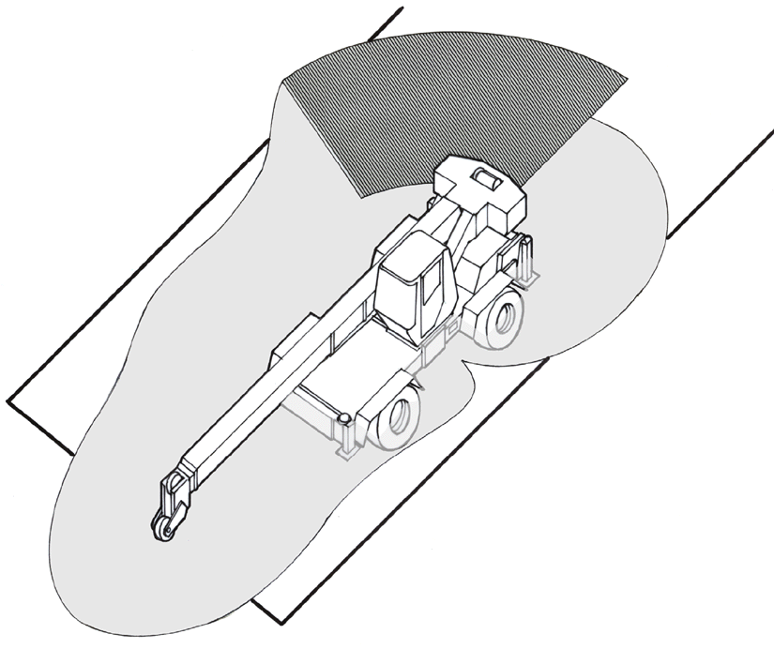
Eye level 7 ft. above ground level
25’ 5”
Area of fully obstructed view
17’ 8”
VEHICLE AND MOBILE EQUIPEMENT SAFETY
15’ 9”
3’ 0”
10’ 0”
16’ 4”
27’ 2”

Slide 20
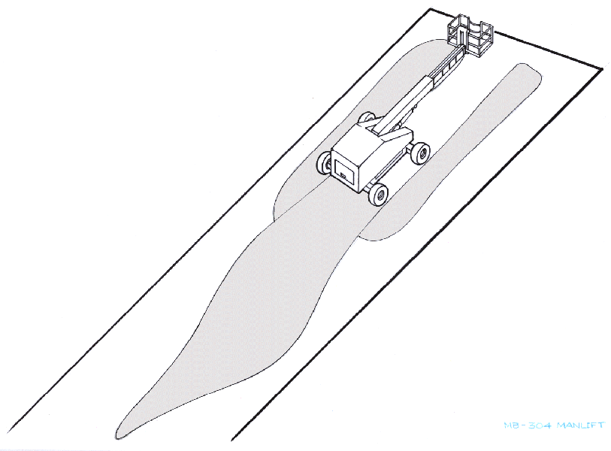
MANLIFT
Eye level 10 ft. above ground level
34’ 0”
36’ 4”
VEHICLE AND MOBILE EQUIPEMENT SAFETY
68’ 0”
95’ 0”
Notes:
Heat Illness most affects those who have not built up a tolerance to the heat (ac·cli·ma·ti·za·tion).
Acclimatization allows us to handle the heat better. The workload for these workers should be gradually increased or they should be allowed more frequent breaks during the first week. Workers might be at greater risk than others if they have not built up a tolerance to hot conditions because they are new to working in hot environments or they have been away from hot working conditions for more than a week. That means that even if the worker has been doing this every summer for many years, there is still an adjustment period when the weather becomes hotter. Everyone is at risk during a heat wave.
OSHA found that acclimatization programs were an integral part of heat illness prevention programs.
OSHA conducted a systematic review of 19 enforcement cases in 2014. 12 were fatalities and the rest were severe heat-related illnesses.
Lack of acclimatization related to severe heat illness or death in was found in 74% of OSHA heat-related 5(a)1 citations from 2012 and 2013.
In addition, lack of heat illness prevention programs in general, but especially the lack of acclimatization, puts workers more at risk for heat-related illness or death.
The focus for this year’s Campaign is getting the word out about acclimatization as an essential element of a comprehensive heat illness prevention program.
Allow workers to get used to hot environments by gradually increasing exposure. New workers and all workers returning from a prolonged absence should begin with 20% of the workload on the first day, increasing incrementally by no more than 20% each subsequent day. During a rapid change in excessively hot weather, even experienced workers should begin on the first day of work in excessive heat with 50% of the normal workload and time spent in the hot environment, 60% on the second day, 80% on day three, and 100% on the fourth day. Full acclimatization may take up to 14 days or longer depending on factors related to the individual or the environment.

Slide 21
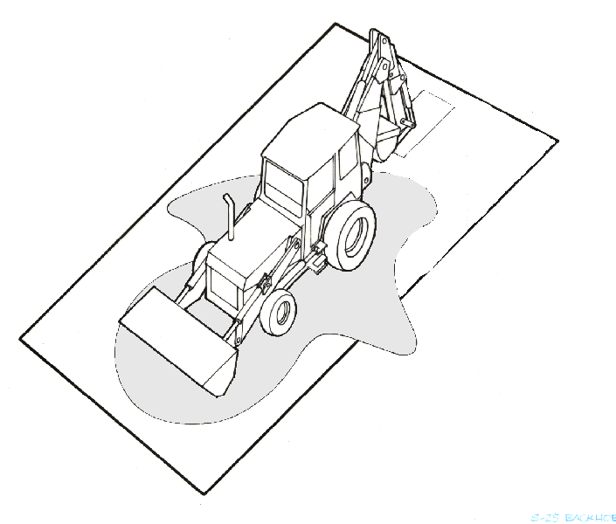
BACKHOE
Eye level 7 ft. above ground level
8’ 4”
29’ 1”
VEHICLE AND MOBILE EQUIPEMENT SAFETY
7’ 7”
18’ 5”

Slide 22
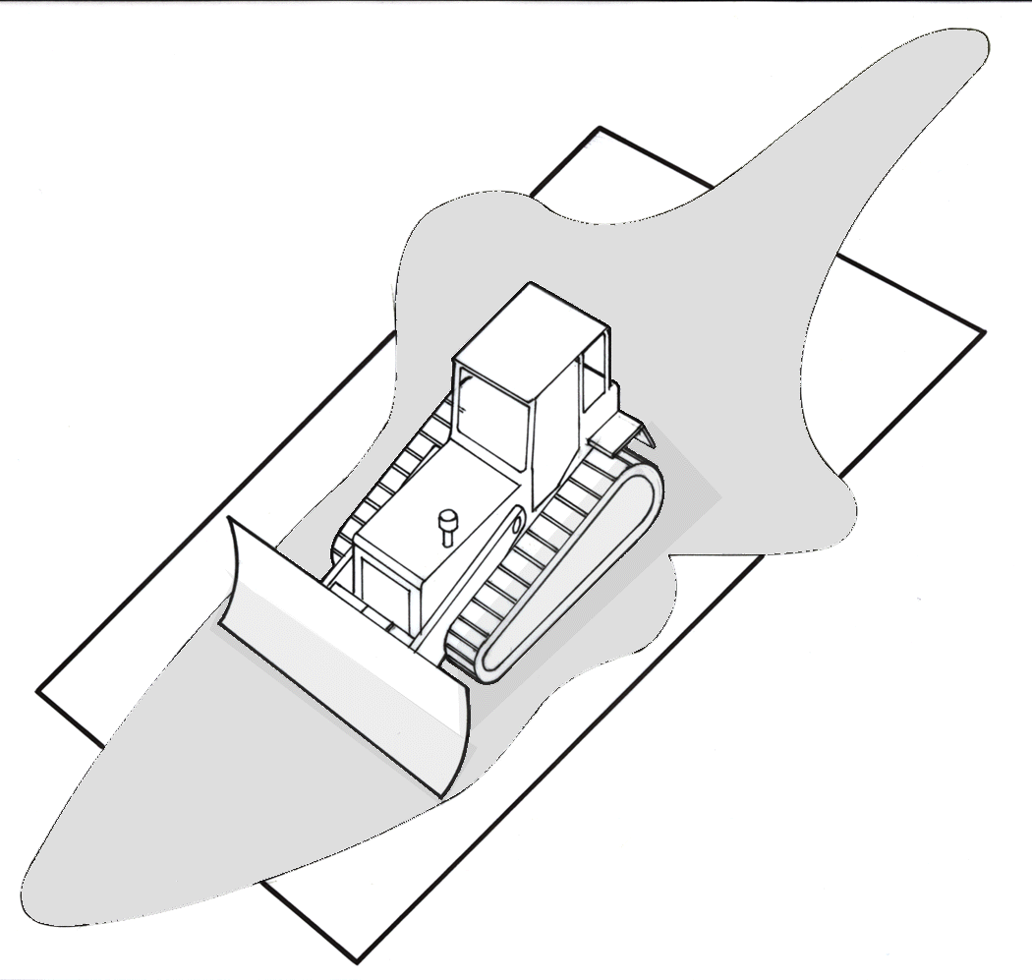
BULLDOZER
16’ 0”
Eye level 6 ft. above ground level
8’ 2”
8’ 2”
12’ 5”
3’ 10”
12’ 1”
VEHICLE AND MOBILE EQUIPEMENT SAFETY
18’ 7”

Slide 23
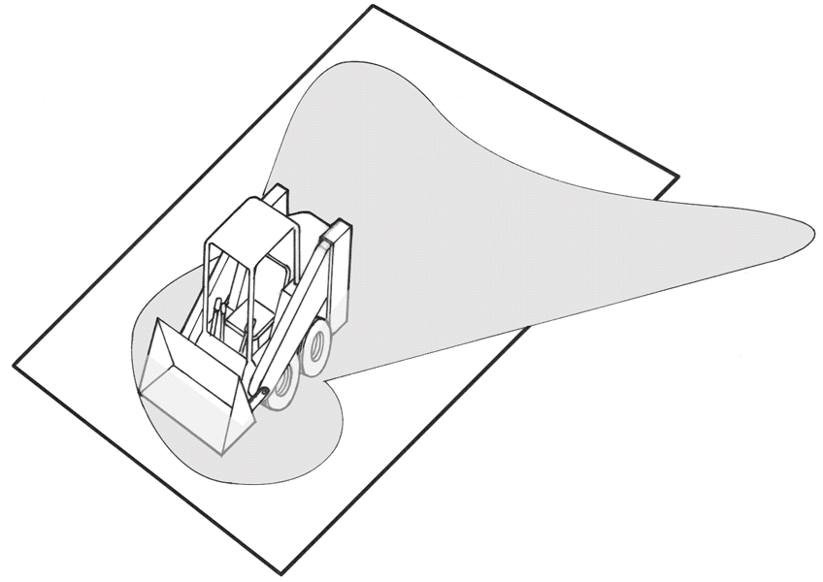
BOBCAT/SKID STEER
Eye level 5 ft. above ground level
11’ 7”
11’ 5”
21’ 8”
4’ 10”
6’ 1”
6’ 3”

Slide 24
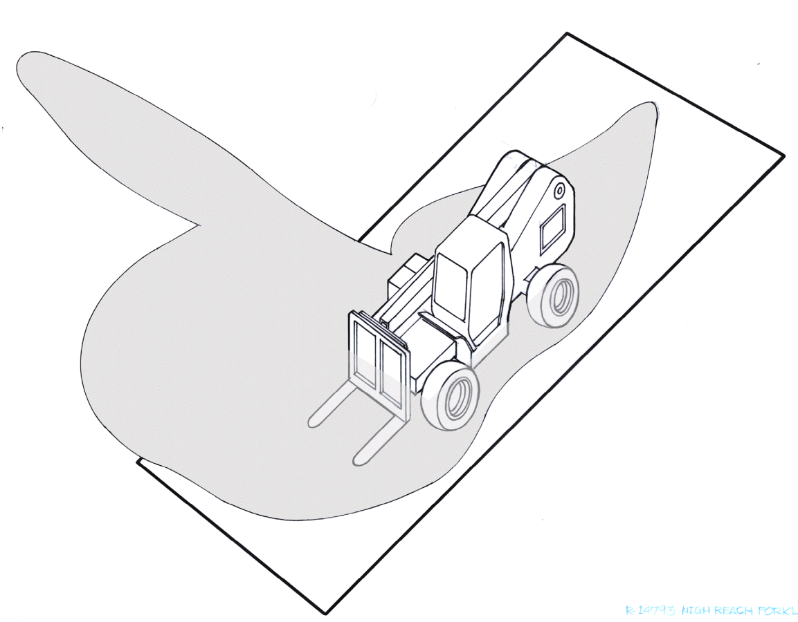
HIGH REACH RT FORKLIFT
Eye level 7 ft. above ground level
85’ 0”
18’ 2”
10’ 9”
39’ 0”
3’ 0”
21’ 2”
14’ 10”

Slide 25
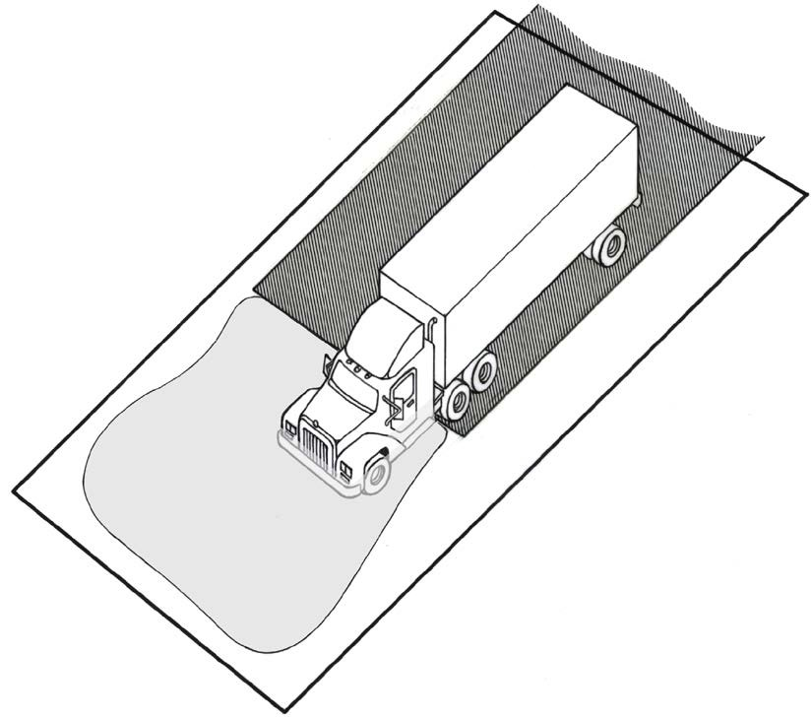



SEMI-TRACTOR TRAILER
Area of fully obstructed view
Eye level 6 – 8 ft. above ground level
27’ 1”
42’ 8”
40’ 6”
36’ 8”
6’ 5”

Slide 26
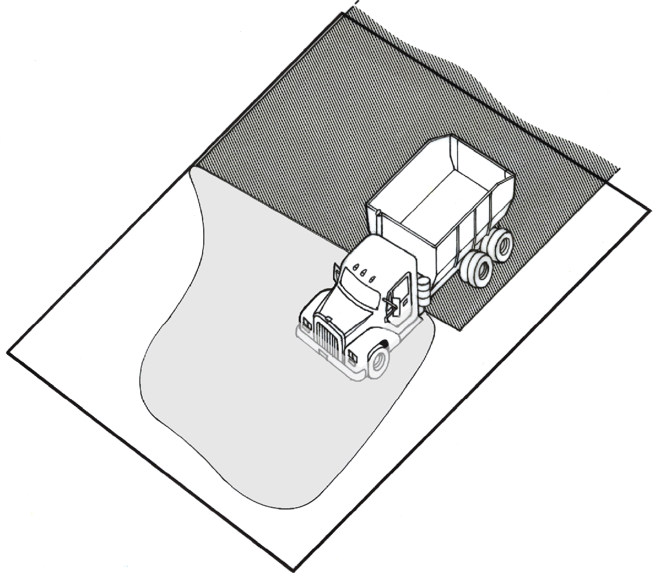
5-TON DUMP TRUCK
Area of fully obstructed view
Eye level 7 ft. above ground level
25’ 0”
22’ 0”
24’ 2”
6’ 0”
22’ 2”

Slide 27
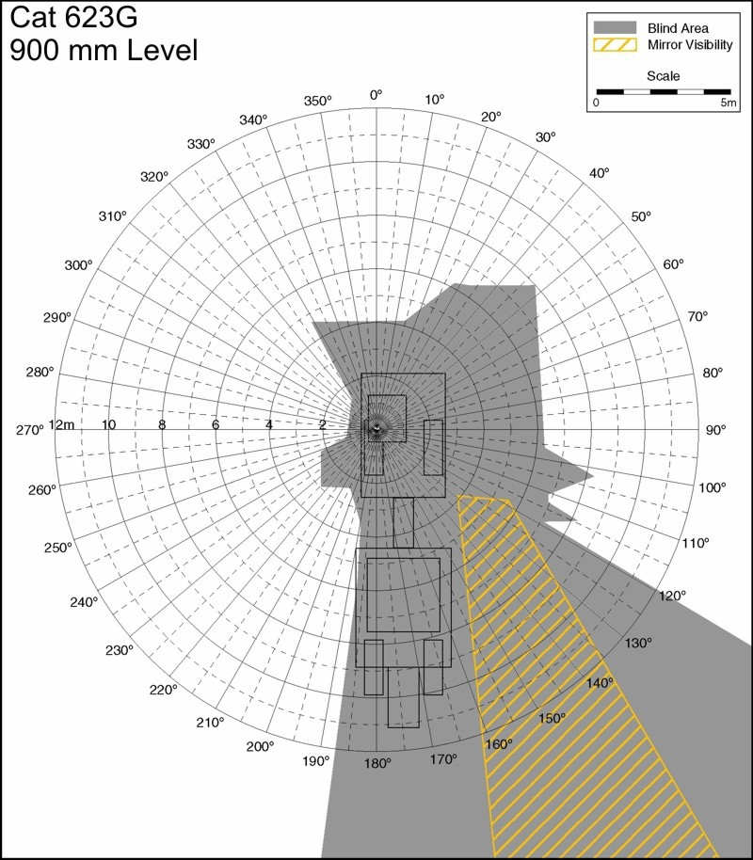
SCRAPER
Detail based on an operator looking at a 3’ tall traffic barrel
24’ 3”
13’ 1.5”
19’ 8”
Area of fully obstructed view

Slide 28
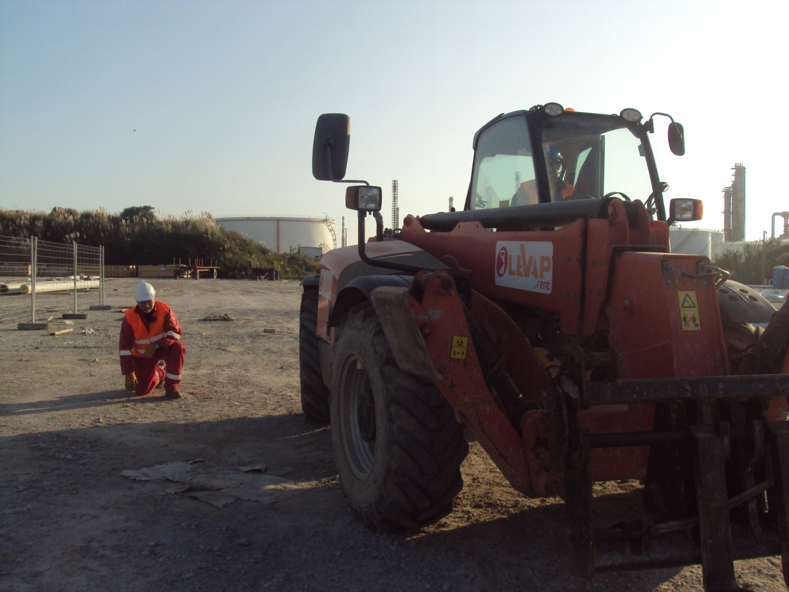
BLIND SPOTS
Even with this vehicle set up with the best view for the operator, this kneeling employee is in a dangerous “blind spot!”

Slide 29
Summary
Evaluate the vehicles/mobile equipment in your work area.
Discuss potential hazardous exposures to your teammates.
Drivers/Operators are encouraged to yse every piece of technology, such as alarms/mirrors/cameras, ect. To enhance overall awareness to pedestrian – vehicle/mobile equipment interface
Make sure everyone on site is watching out for others entering these hazard zones
Order the “STOP MOVEMENT” of a vehicle/mobile equipment … and re-align if there ia a concern for safety
Use our Safety Task Assignment to align the safety awareness of our teammates when working in congested areas or in close proximity to vehicle/mobile equipment
As always, never take anyone’s safety for granted

Slide 30
Blind Spot Awareness
This presentation is intended to raise awareness to the hazards of blind spots and the need to ALWAYS be aware of our surroundings. Whether we are the operators or just visitors to a job site, we must be aware of where we are and do as much as possible to eliminate the potential for a serious injury or fatality.

Slide 31
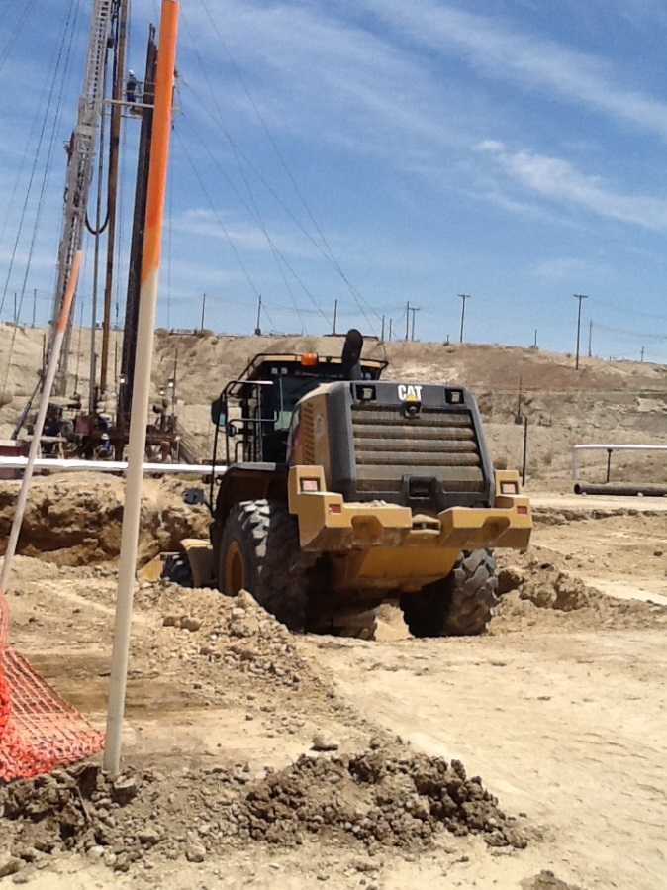
Job site communication is critical to everyone’s goal of incident free operations.
Stop at meet and greet areas before entering a job site.
Be aware of hazards on job site.
Use stop work authority if something is not right.

Slide 32
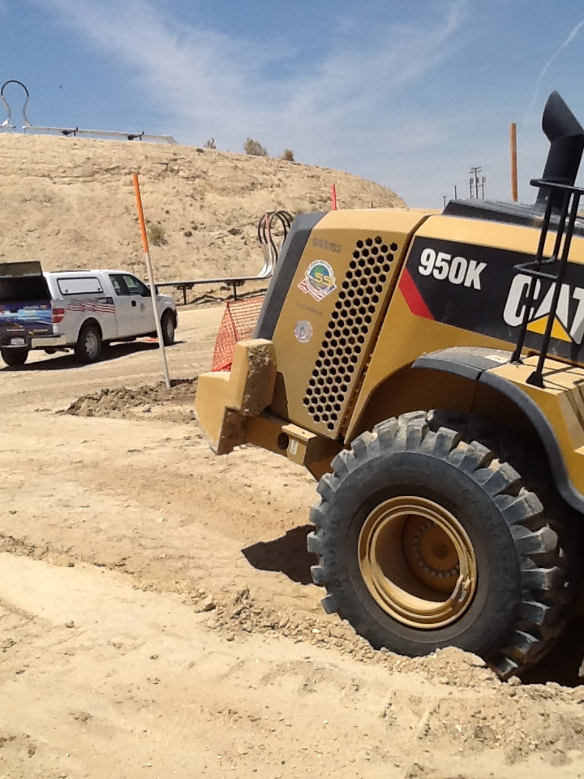
Park only in designated areas.
Never park behind moving equipment.
Make sure operator sees you before entering job site.
The average truck is 18’ long but can still be hidden in blind spots.

Slide 33
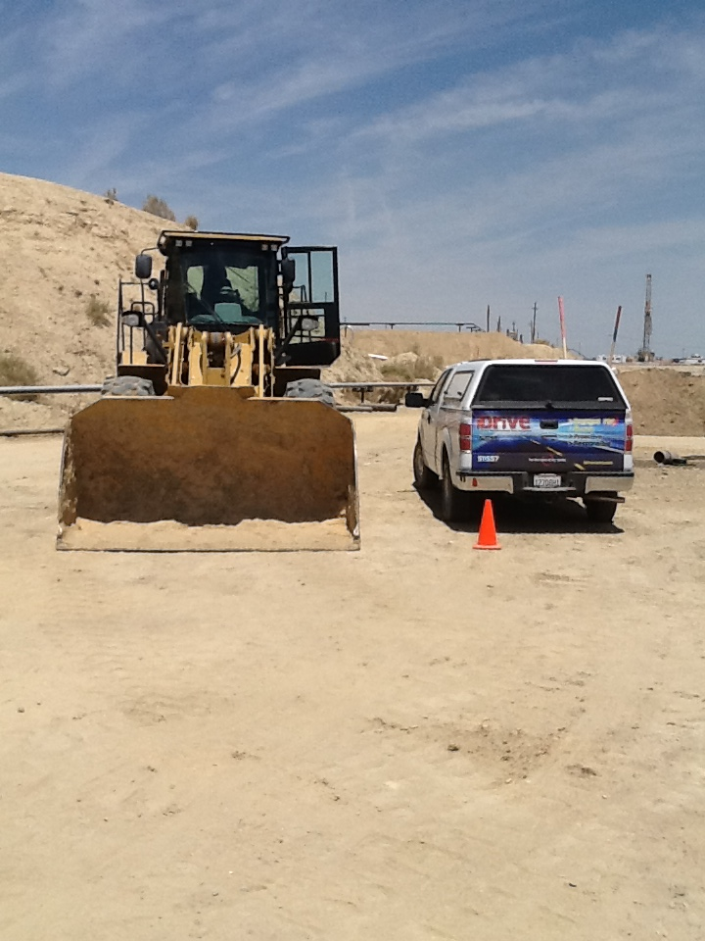
Communication
YOU CAN SEE THE HEAVY EQUIPMENT, BUT CAN THEY SEE YOU?

Slide 34
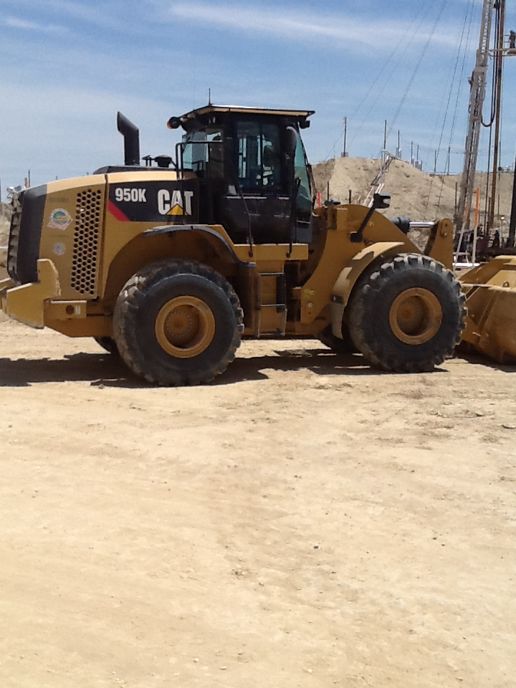
Communication
Can you see the truck in this picture?

Slide 35
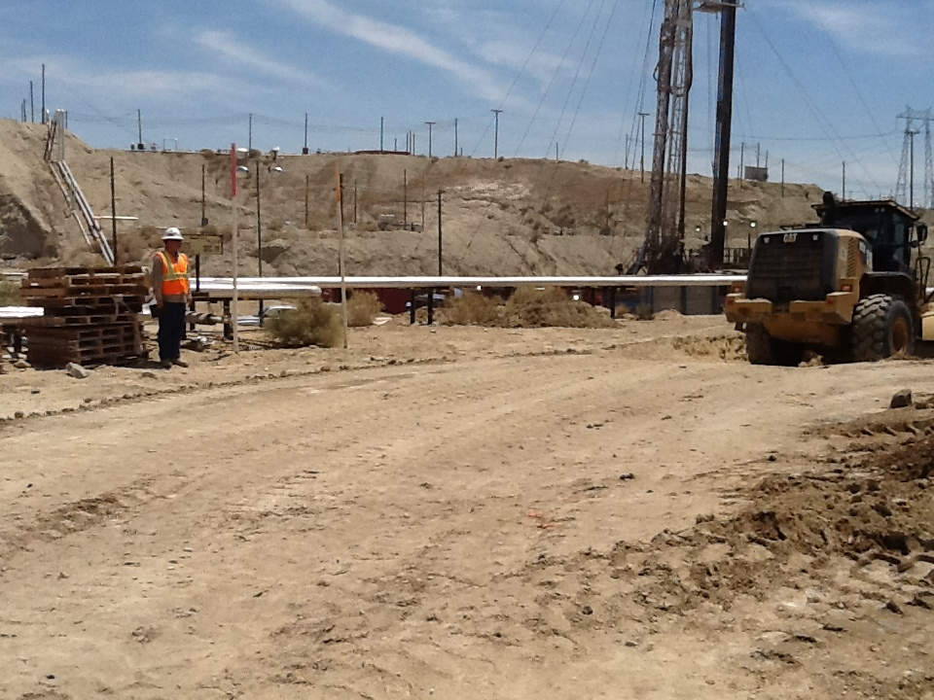
At this distance and angle the operator was only able to see the top half of the pedestrian in his blind spot.

Slide 36
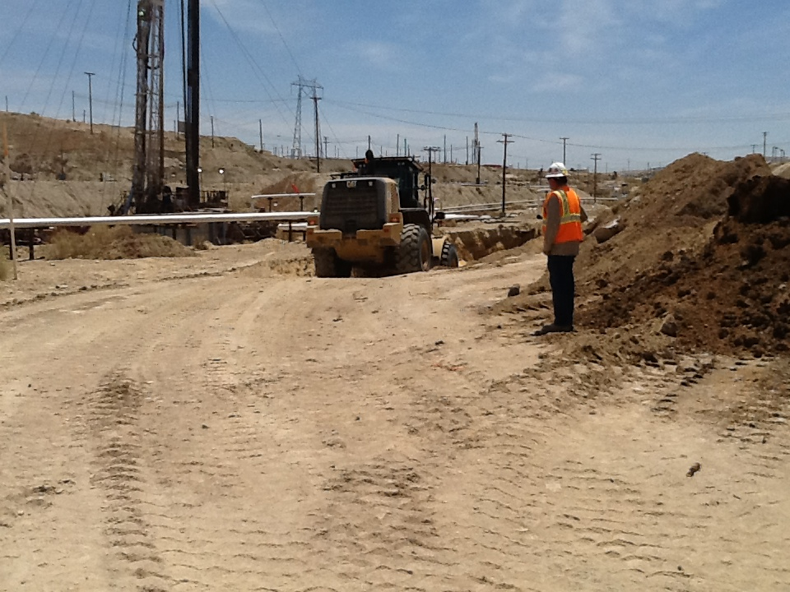
At approximately 40’ the operator had full view of the pedestrian on the job site.

Slide 37
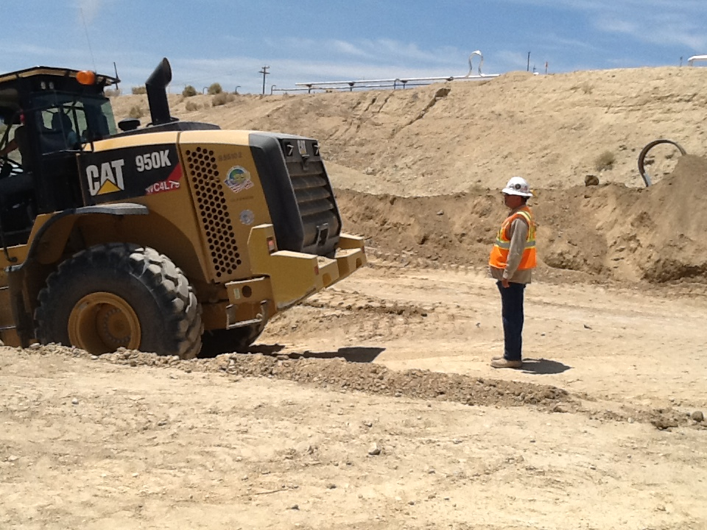
Location of back up camera.
From directly behind the loader the operator was able to see the pedestrian with the assistance of the equipped back up camera.

Slide 38
Warning:
Not all heavy equipment comes equipped with a back up camera. Nor should the operator fully rely on the camera for back up assistance. The operator should ALWAYS clear the blind spots by looking over shoulders, and if necessary, getting out of the equipment to see what is behind them before backing. In some cases, a spotter is required due to congested work areas.

Slide 39

This video serves to illustrate the distance required to see a pedestrian or object directly behind a loader.

Slide 40
This clip shows the lack of visibility behind a Motor Grader.

Slide 41
In Closing:
ALWAYS – Park in designated areas.
ALWAYS – Make sure they see you.
ALWAYS – Maintain effective communication.
ALWAYS – Check blind spots before backing.
ALWAYS – Get out and look if you are not sure.
ALWAYS – Use stop work authority if needed.

Slide 42
?
ANY QUESTIONS
OR COMMENTS

Slide 43



Refreshment/Break
Please take a break for 10 minutes!
Meet and greet your fellow attendees, get some
refreshments, and then we’ll come back and continue.

Slide 44

LET’S RAFFLE!

Slide 45
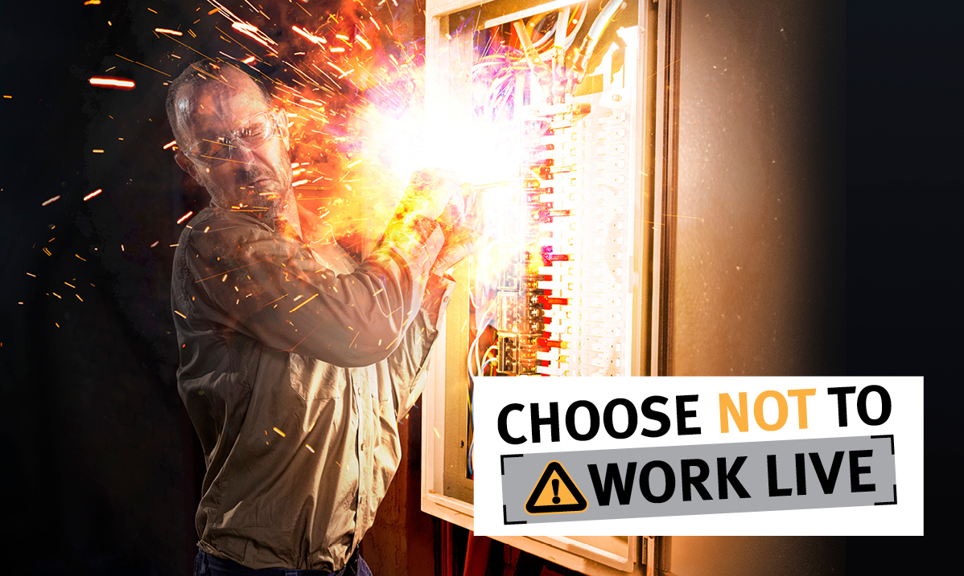
Electrical Safety
Arc Flash
Big G Electric and Engineering

Slide 46
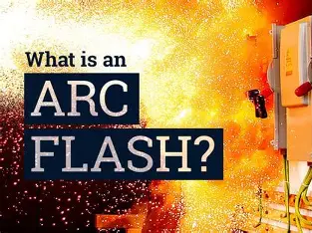
PPE

Slide 47
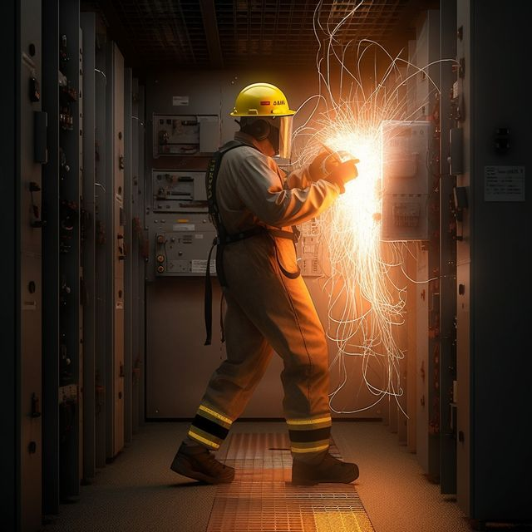
What is an Arc Flash
Electrical short circuitor arc through the air
Concentrated energy explodes outward
High-intensity flash
Instantaneous arc blast pressure wave
Superheated ball of gas melts, metal, burns clothes and skin.
"Electricians recognize that an arc blast is a powerful concussive shock wave resulting from the rapid vaporization and ignition of molten metals. When copper transitions from its solid state during an arc event, it expands up to 67,000 times in volume, contributing significantly to the explosive force of the blast."

Slide 48
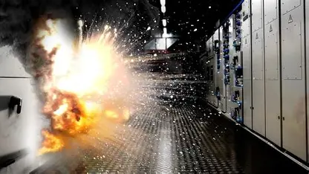
PPE
WHY AND HOW DOES ARC FLASH HAPPEN?

Slide 49
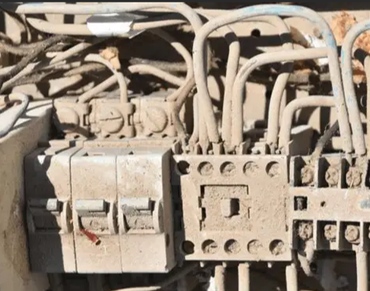
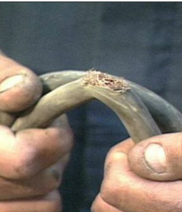
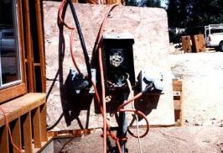
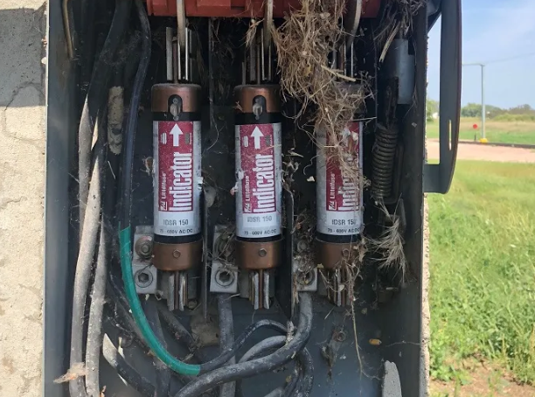
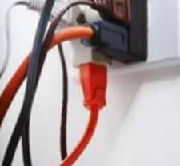
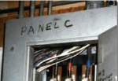
Three Primary Causes of Arc Flash
Equipment Failure
Insulation breakdown, corrosion, or faulty components due to aging or poor maintenance, overvoltage or short circuit.
Human Error
Using wrong tools, dropping conductive objects, or not following lockout/tagout procedures.
Environmental Conditions
Presence of dust, moisture, or contaminants that reduce insulation and increase conductivity.

Slide 50
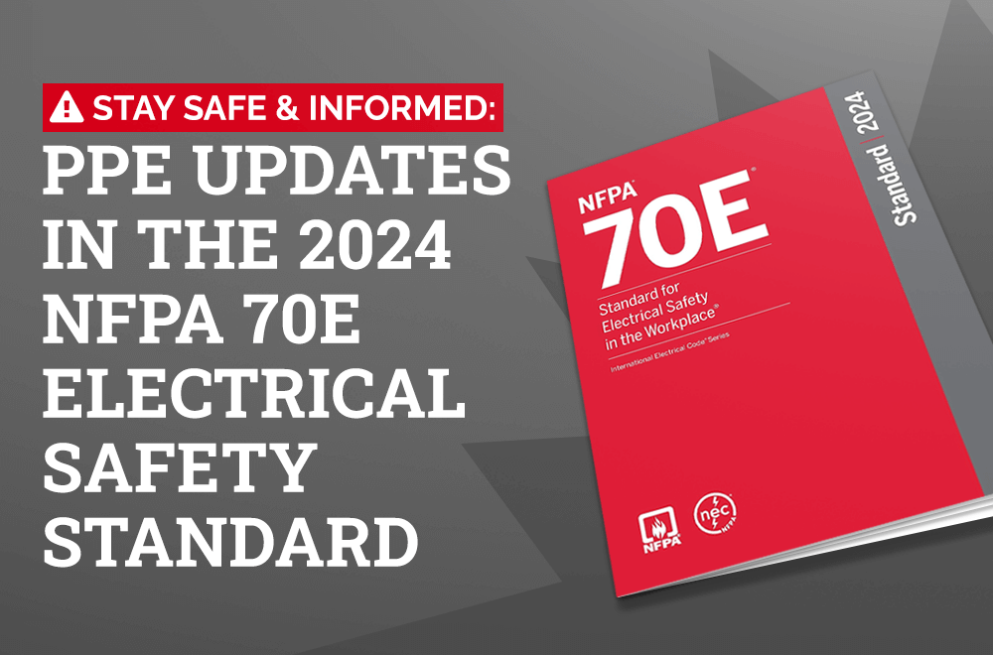
How to Prevent Arc Flash
QUALIFIED AND/OR AUTHORIZED PERSONNEL
(NFPA 70E – 2024)
Qualified: Skilled in electrical systems and trained to recognize hazards
Trained: Can assess risks, understand arc flash boundaries, and choose proper PPE
Authorized: Approved by employer to perform specific electrical tasks

Slide 51
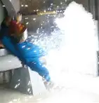
Arc Flash Effects
Severe burns
Fireball destroys skin and tissue
Heat blast can extend several feet from source
Burns from hot surfaces, projectiles, and fireball
Hearing loss
Extensive damage to equipment
Punctures and lacerations

Slide 52
WARNING
"Content Advisory: The following slides contain images that some viewers may find disturbing."

Slide 53
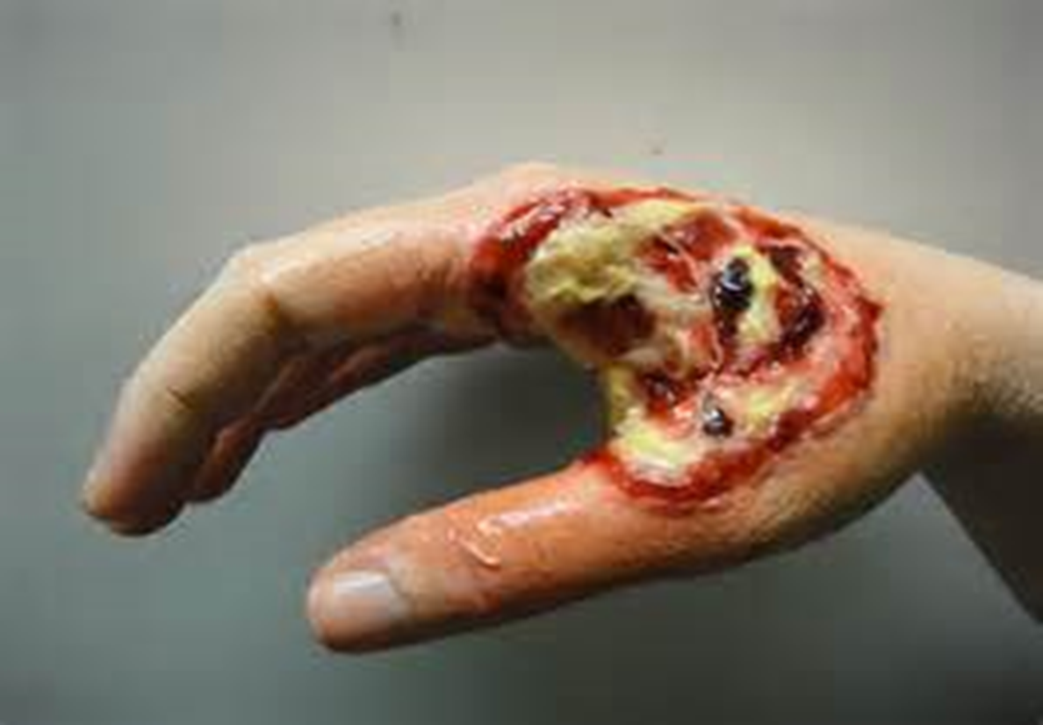
Injuries
I was just checking for voltage with my meter!

Slide 54
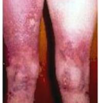
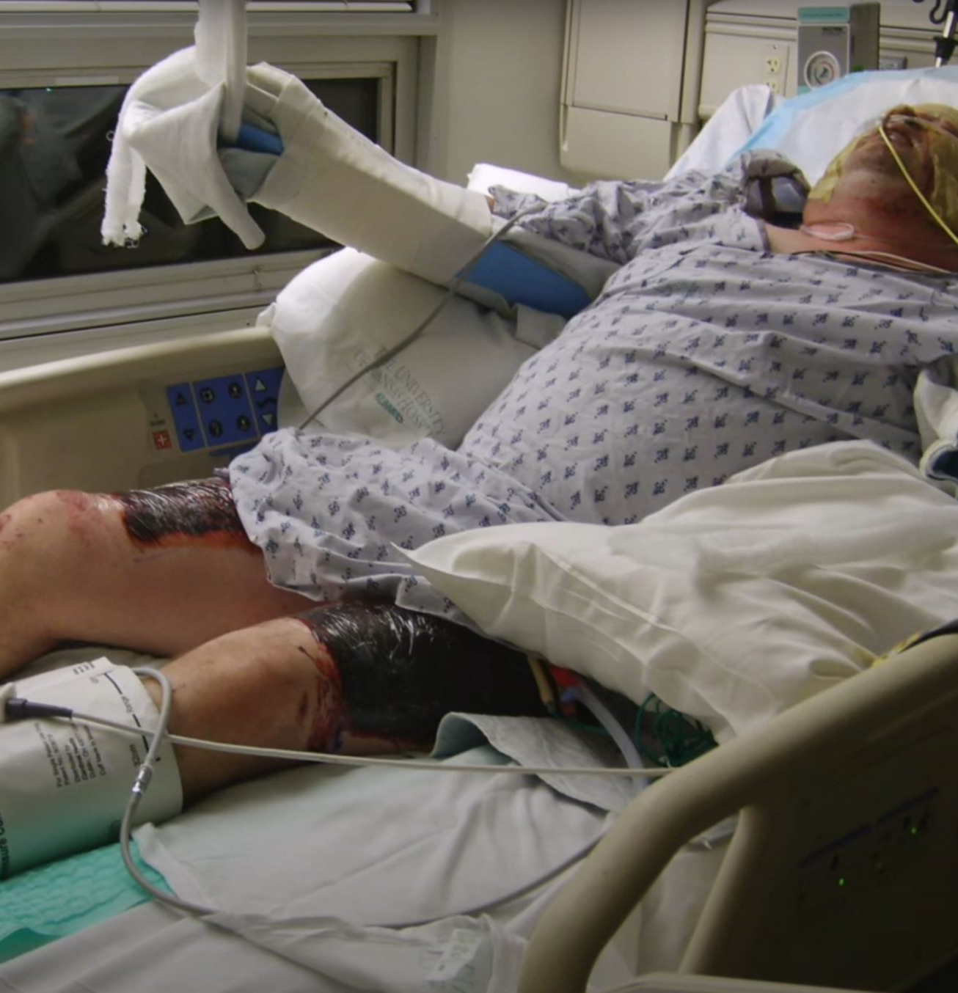
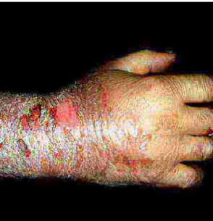
Injuries
If only I had my PPE

Slide 55
How to Prevent Arc Flash
Continued -
QUALIFIED AND/OR AUTHORIZED PERSONNEL
Authorized Person
(NFPA 70E – 2024)
Permitted by employer for specific duties or locations
May or may not be qualified, depending on the task
Example: Can enter restricted area, but not perform energized work unless qualified

Slide 56
Role | OSHA Requirement | NFPA 70E Requirement (2024 Update)
Qualified | Training in identifying live parts, voltage, and safe approach distances | Demonstrated knowledge, hazard recognition, PPE use, and risk assessment skills
Unqualified | Basic Electrical safety training if exposed to hazards | Must stay outside the limited approach boundary unless escorted
Authorized | Not Specifically defined by OSHA | Employer- designated for specific tasks or access; may or may not be qualified
Summary of Key Requirements (Should know)

Slide 57
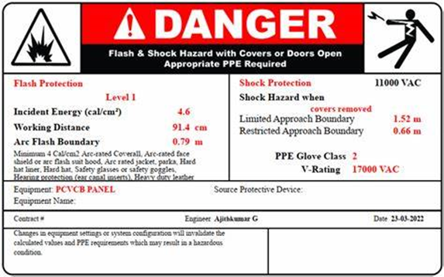
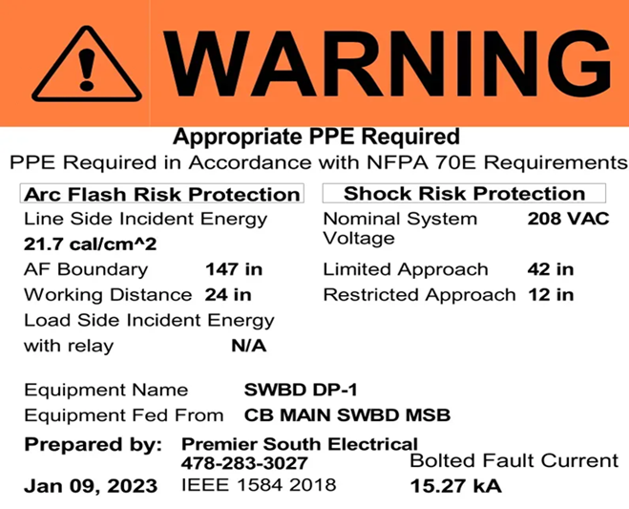
Arc Flash Label Requirements
OSHA
Requires safe work practices
Follows NFPA 70E for guidance
NFPA 70E (2024)
Labels required on energized equipment
Must include:
  Voltage
  Arc flash boundary
  PPE info (incident energy or arc rating
Review every 5 years or after system changes
NEC (2023)
Labels required on panels ≥1000A
Must be:
Durable and visible
Not handwritten (unless updated often)

Slide 58

Proper PPE For The JOB
Arc Flash PPE – Key Points
Purpose: Protects against burns, heat, and flying debris from an arc flash event
Includes:
Protects from burns, heat, and debris
Includes arc-rated clothing, gloves, face shield/hood
Chosen based on arc flash risk level
Must meet NFPA 70E and ASTM standards

Slide 59


Arc Flash Bounderies

Slide 60

Required Job Hazard Analysis
(Hazard Assessment
Arc Flash Hazard Assessment
(OSHA/NFPA 70E) OSHA Requires it.
Hazard Analysis: Identify risks, calculate incident energy (cal/cm²)
Qualified Personnel: Only trained individuals may assess or work near energized parts
Labeling: Must show incident energy, arc boundary, PPE, and working distance
PPE: Provide arc-rated gear per energy level (NFPA 70E, ASTM F1506)
Training: Every 3 years or with job changes
LOTO: De-energize and lock/tag per OSHA 1910.147
Written Program: Maintain documented electrical safety procedures

Slide 61






PPE

Slide 62


Slide 63


Slide 64

LET’S RAFFLE!

Slide 65

LET’S RAFFLE!

Slide 66
SAFETY REVIEW
FRANK SAVAGE

Slide 67
INCIDENTS & NEAR MISSES
2025 HSE Incidents
No New Incidents or Spills to Report
This is because of the people in this room and in this company. Your dedication to EnXL and keeping each other safe.
We need you–work safely

Slide 68

INCIDENTS & NEAR MISSES
Snakes
Watch where you place your hands and feet when removing debris. If possible, don’t place your fingers under debris you are moving. Wear heavy gloves.
If you see a snake, step back and allow it to proceed.
Wear boots at least 10 inches high.
Watch for snakes sunning on fallen trees, limbs or other debris.
A snake’s striking distance is about 1/2 the total length of the snake.
If bitten, note the color and shape of the snake’s head to help with treatment.
Keep bite victims still and calm to slow the spread of venom in case the snake is poisonous. Seek medical attention as soon as possible.
Do not cut the wound or attempt to suck out the venom. Apply first aid: lay the person down so that the bite is below the level of the heart, and cover the bite with a clean, dry dressing.

Slide 69
?
ANY QUESTIONS
OR COMMENTS

Slide 70

LOOKING FOR “VOLUNTEERS”
November Contractor Safety Meeting
OPEN TO SUGGESTIONS FOR TOPICS

Slide 71

BRUCE JOHNSON
CEO - EnXL

Slide 72
STAY SAFE!
THANK YOU FOR ATTENDING OUR Q3 CONTRACTOR SAFETY MEETING!
Next Contractor Safety Meeting:
November 13, 2025

Slide 73
Backup Slides

Slide 74
Fraud and Scams
Identity Fraud and Scams Cost Americans $47 Billion in 2024
American adults lost $47 billion to identity fraud and scams in 2024, an increase of $4 billion over 2023, according to a new report produced by Javelin Strategy & Research and cosponsored by AARP.
Based on a survey of 5,023 U.S. adults, that total includes $27 billion lost to traditional identity fraud, which affected more people — 18 million — than in 2023 (when the number was 15 million and $23 billion was lost). Traditional identity fraud occurs when a criminal deceives an organization by obtaining and using someone else’s personal information, such as a Social Security number, home address, date of birth or bank account data, and uses it fraudulently.

Slide 75

Personal Protective Equipment

Slide 76
?
ANY QUESTIONS
OR COMMENTS

