Slide 1
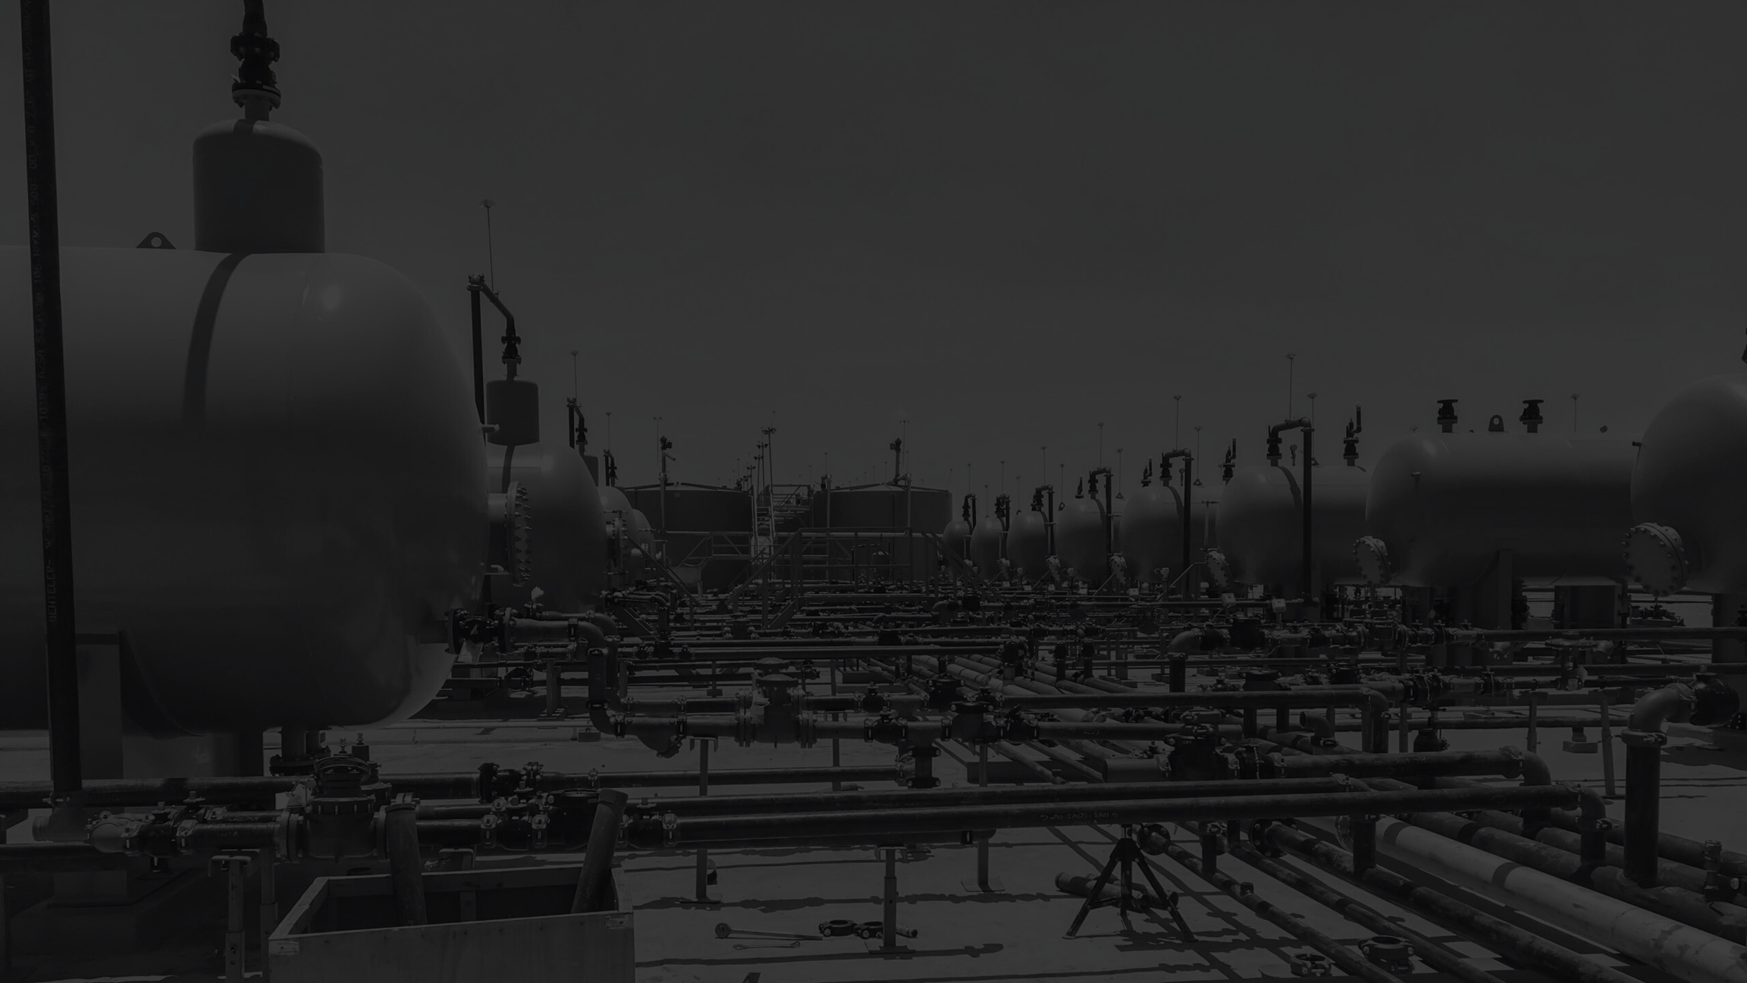

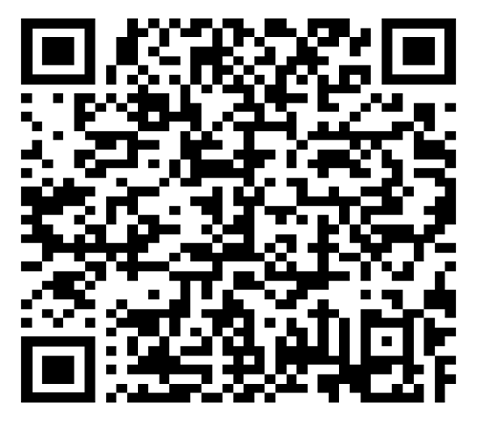
Q2 2025
Contractor Safety Meeting
Scan the QR code to sign-in.
Welcome!
We will begin shortly!

Slide 2
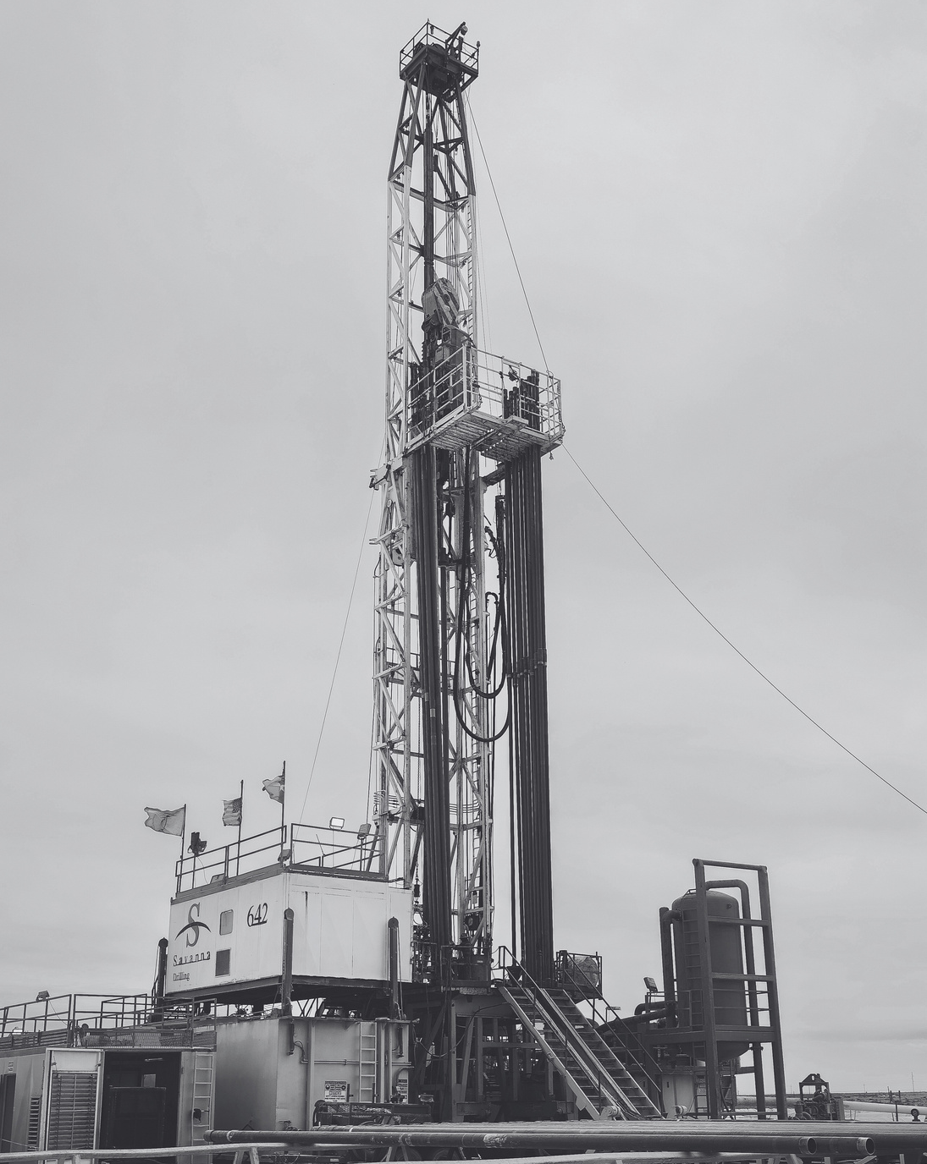

MEETING PROTOCOLS
In Case of an Emergency:
  Jonathan Conners Petroleum Museum Director of Rentals
  Exits & Muster Points
Please put phones on vibrate. If you need to take a call, please step outside.
Restrooms are to your right and out through the double doors.
We ask that you participate in the discussion!

Slide 3
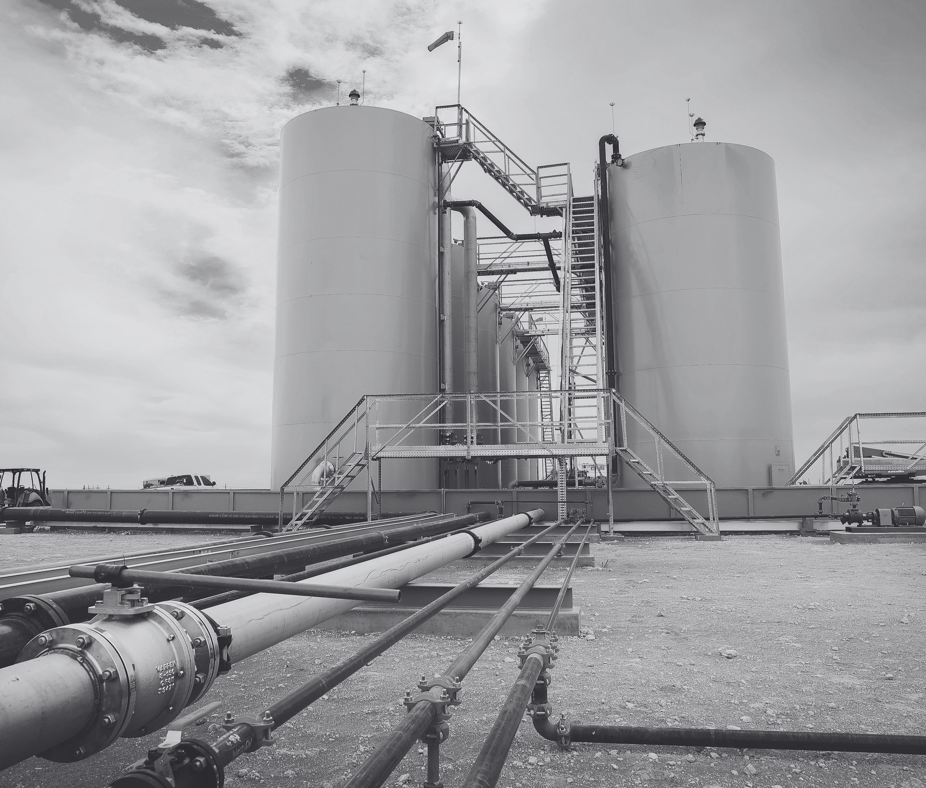
AGENDA
Welcome & Introductions
Safety Moment
  Complacency – Frank Savage
EnXL Safety Meeting Topics:
  Courage of Ownership – Dr. Noah Dean – American Safety
  Heat Stress– James Lynch –
  Tellus Services
Safety Statistics – Frank Savage
CEO Comments - Bruce Johnson
Conclusion

Slide 4

QR Code to Sign-in
Select Meeting: Drop Down –
Everything else is your information – Please fill out completely.
Please sign and submit
The information will also be used for our drawings.

Slide 5
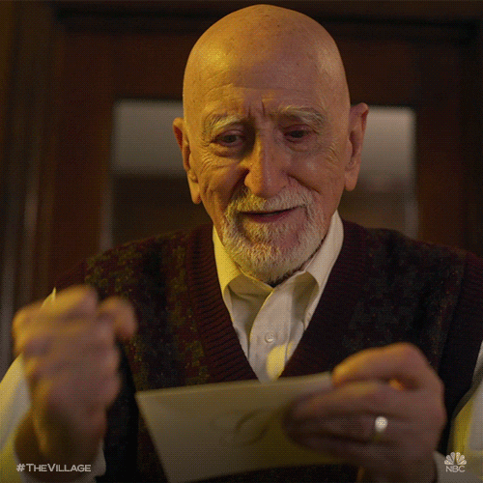
LET’S RAFFLE!

Slide 6
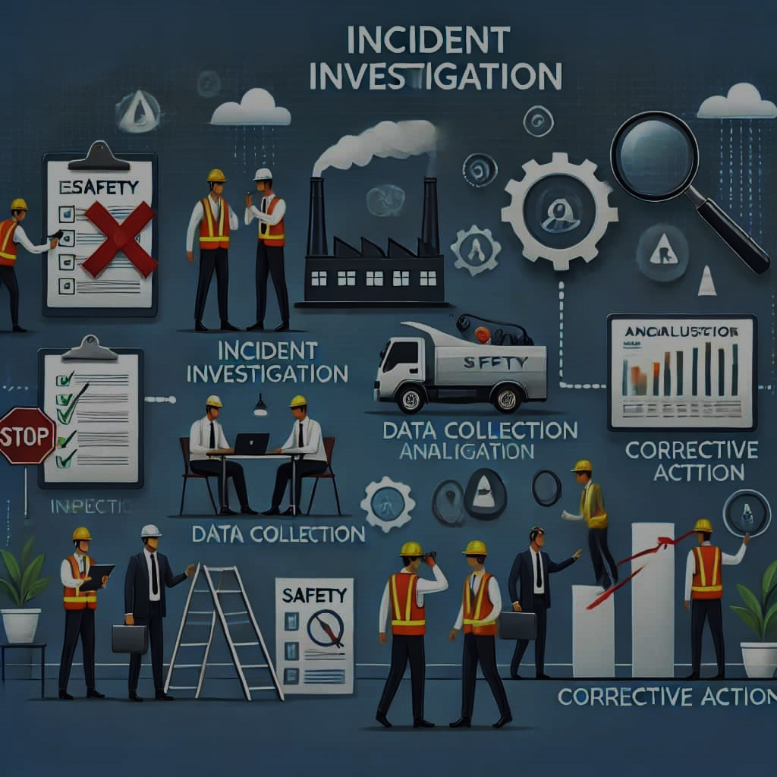
SAFETY MOMENT
FRANK SAVAGE

Slide 7
Incident Reporting
Steps to Write an Effective Incident Report
Creating an effective incident report involves a systematic approach to ensure all necessary information is captured accurately and comprehensively.
1. Respond to the Incident
  Ensure Safety: Prioritize the safety and well-being of all individuals involved
  Provide First Aid: Administer necessary first aid or medical assistance
  Secure the Scene: Prevent further damage or injury by controlling the incident area
2. Gather Information
  Interview Involved Parties: Speak with those directly involved and any witnesses to obtain firsthand accounts
  Collect Evidence: Take photographs, gather physical evidence, and secure relevant documents
  Document Conditions: Note environmental conditions, equipment states, and any other factors relevant to the incident

Slide 8
Incident Reporting
3. Complete the Report Promptly
  Timeliness: Complete the report as soon as possible while details are fresh
  Accuracy: Ensure all information is accurate and free from personal bias
  Clarity: Use clear and concise language to describe the incident
4. Use a Structured Format
  Standard Template: Utilize a standardized form or template to ensure consistency
  Logical Flow: Present information in a logical sequence, typically following the incident’s timeline
5. Review and Edit
  Proofread: Check for grammatical errors and ensure clarity
  Verify Facts: Confirm all details and information are correct
  Seek Feedback: Have a supervisor or colleague review the report for completeness
6. Submit and Follow Up
  Submit to Appropriate Channels: Ensure the report reaches the designated authority or department
  Track Actions: Monitor the implementation of any recommended preventive measures
  Maintain Records: Keep a copy of the report for organizational records and future reference

Slide 9

?
ANY QUESTIONS
OR COMMENTS

Slide 10

LET’S RAFFLE!

Slide 11


THE COURAGE OF OWNERSHIP
Understanding the Well-Kept Secret of
Control
Dr. Noah Dean
Chief Strategy Officer

Slide 12
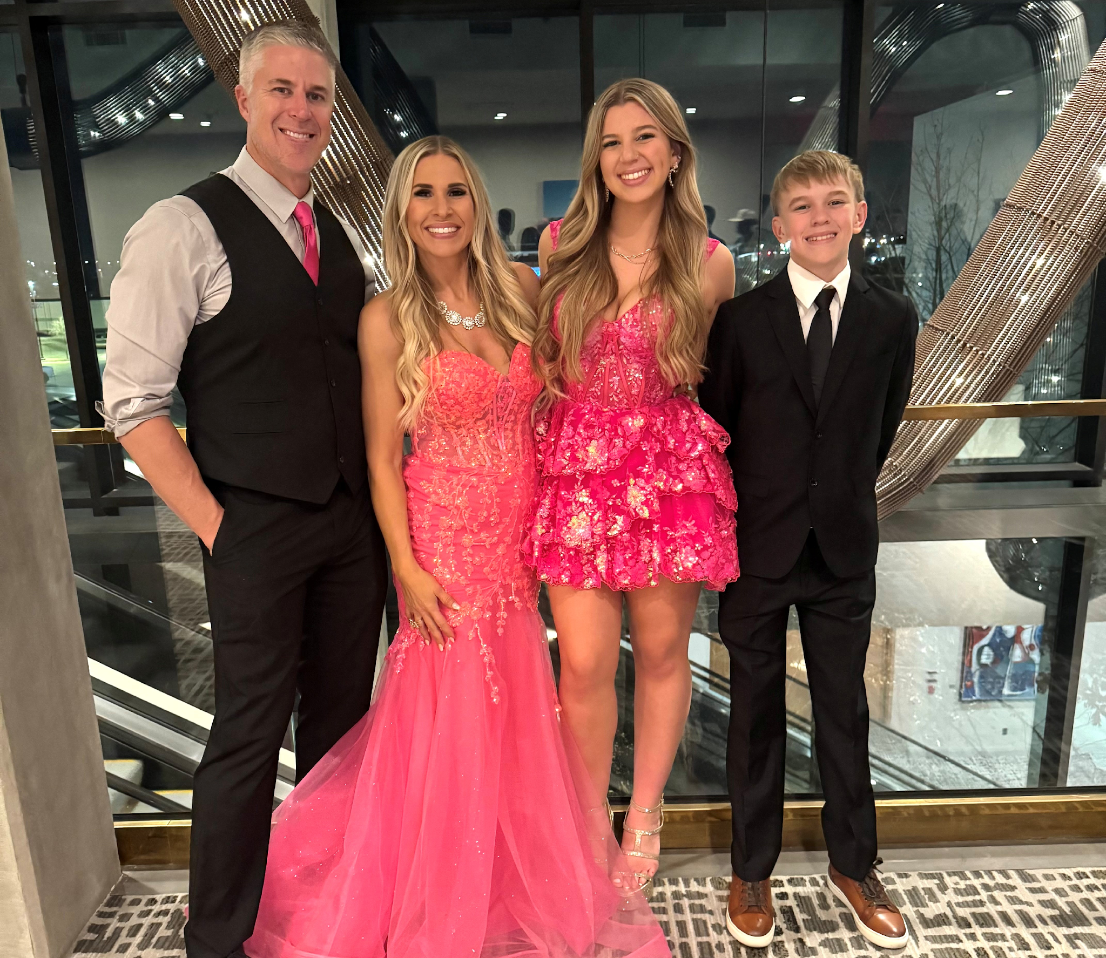
DEAN’S

Slide 14
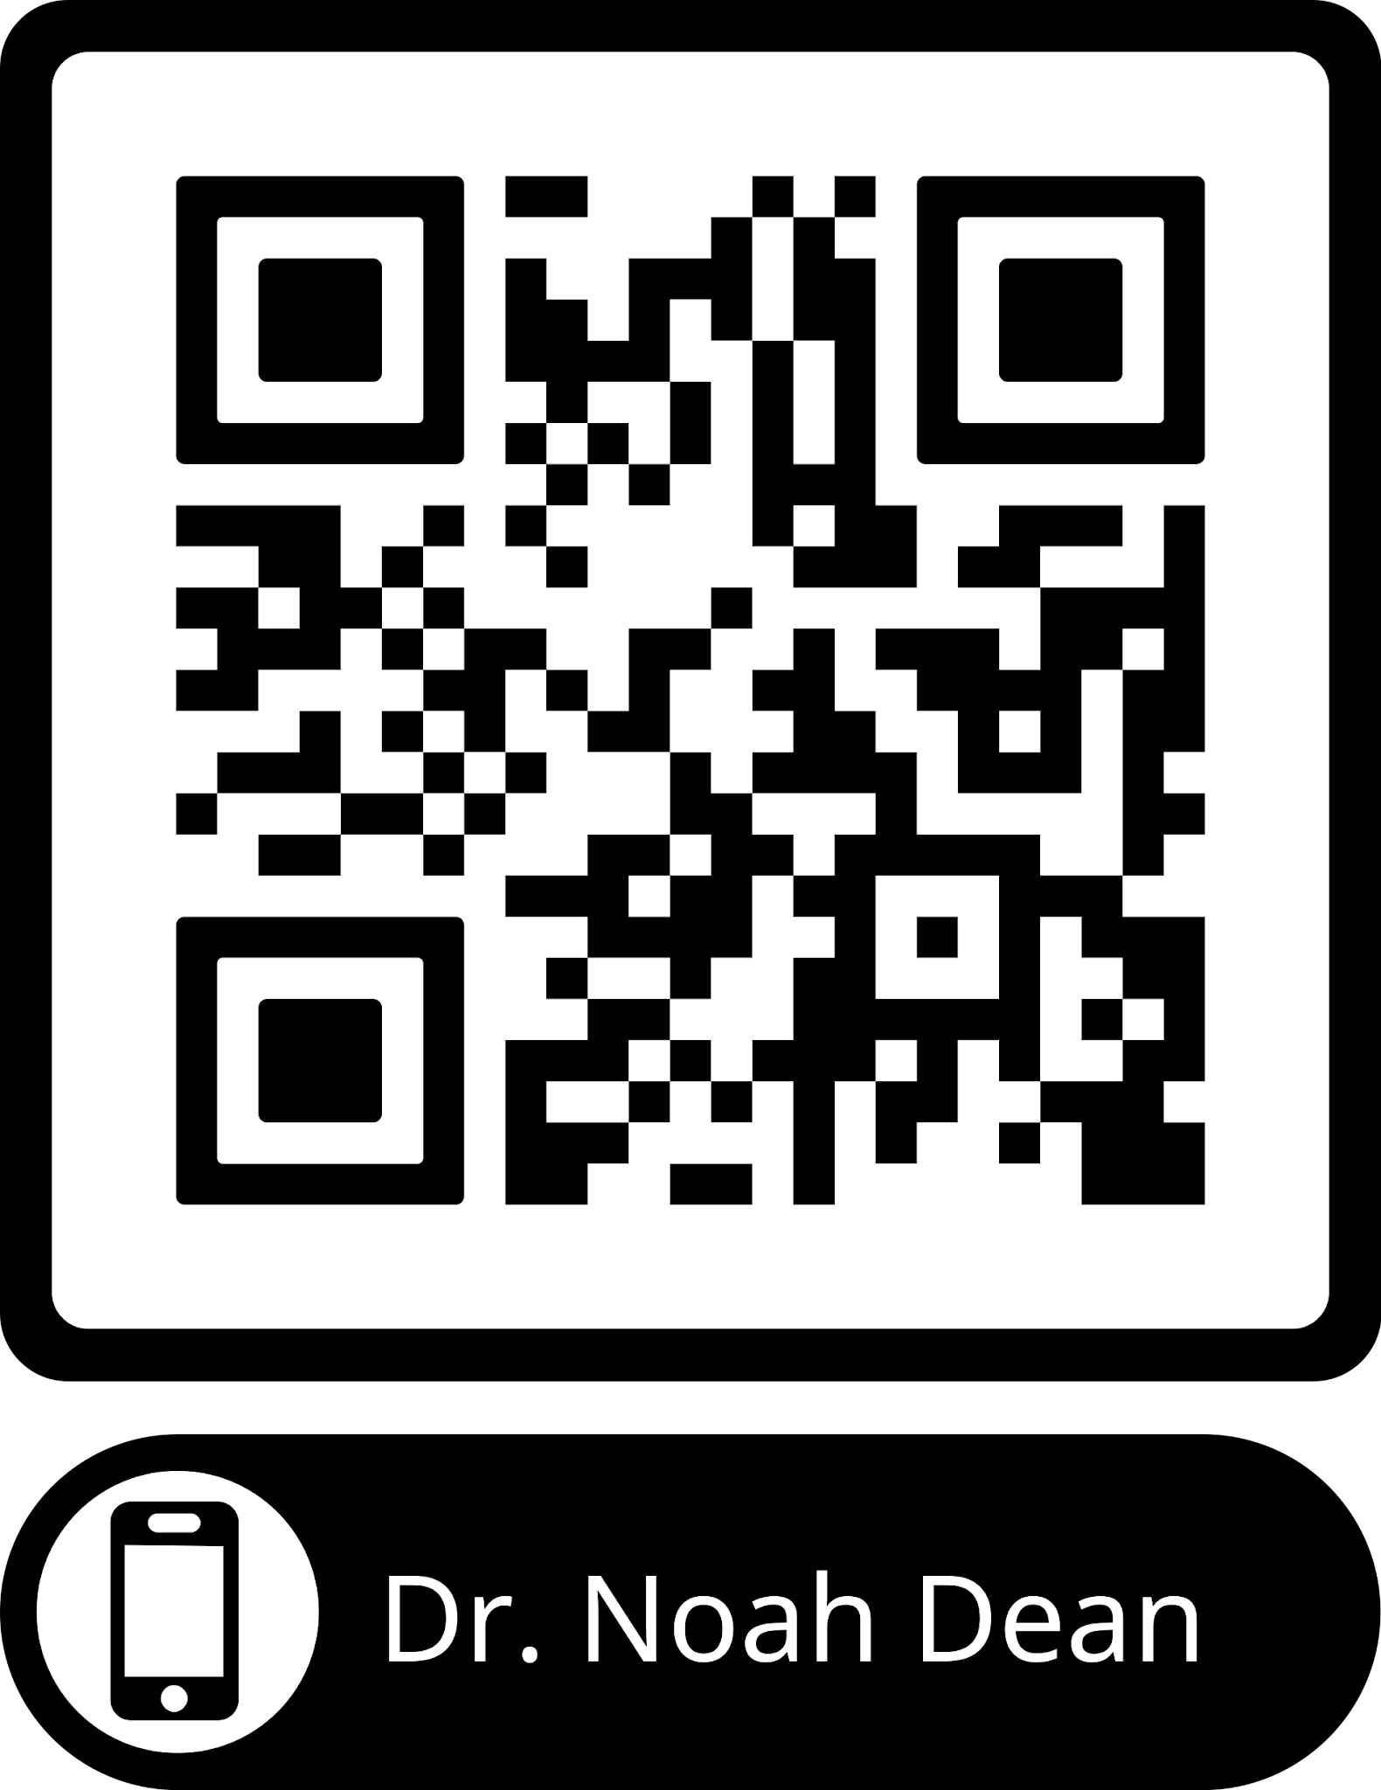
ANY QUESTIONS
OR COMMENTS
?

Slide 15

LET’S RAFFLE!

Slide 16
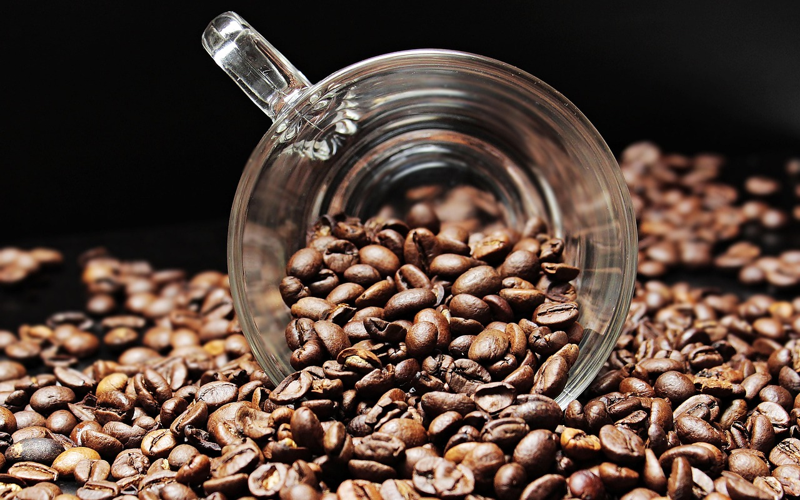


Refreshment/Break
Please take a break for 10 minutes!
Meet and greet your fellow attendees, get some
refreshments, and then we’ll come back and continue.

Slide 17

LET’S RAFFLE!

Slide 18
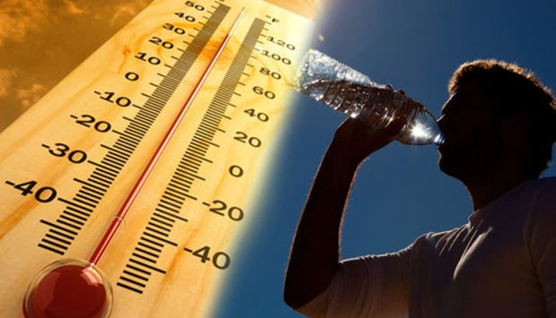
Recognizing and Preventing Heat Related Illnesses
James Lynch
President Safety & Compliance
Tellus Companies

Slide 19
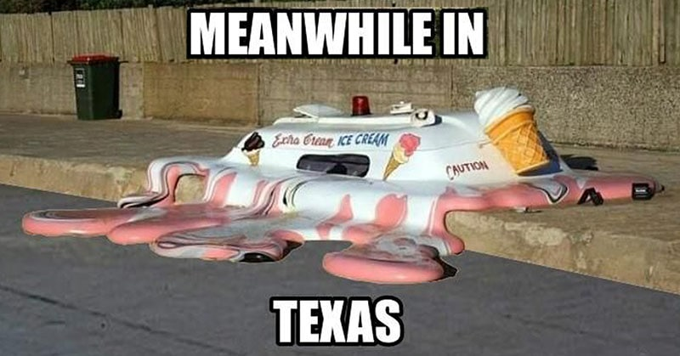
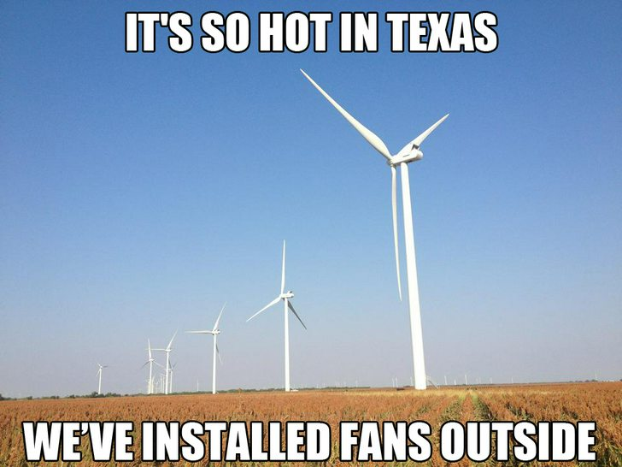
Recognizing and Preventing Heat
Related Illnesses
Presented by:
James Lynch
Tellus Services

Slide 20
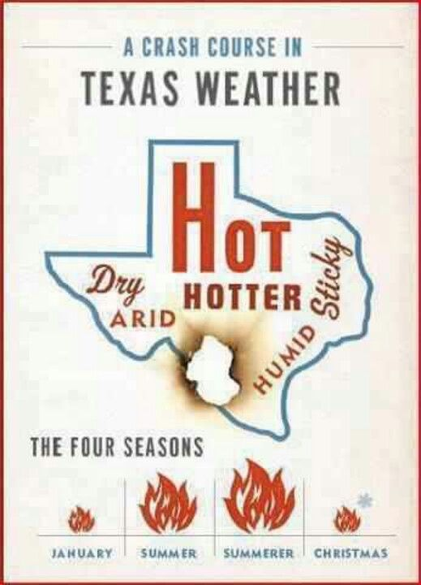
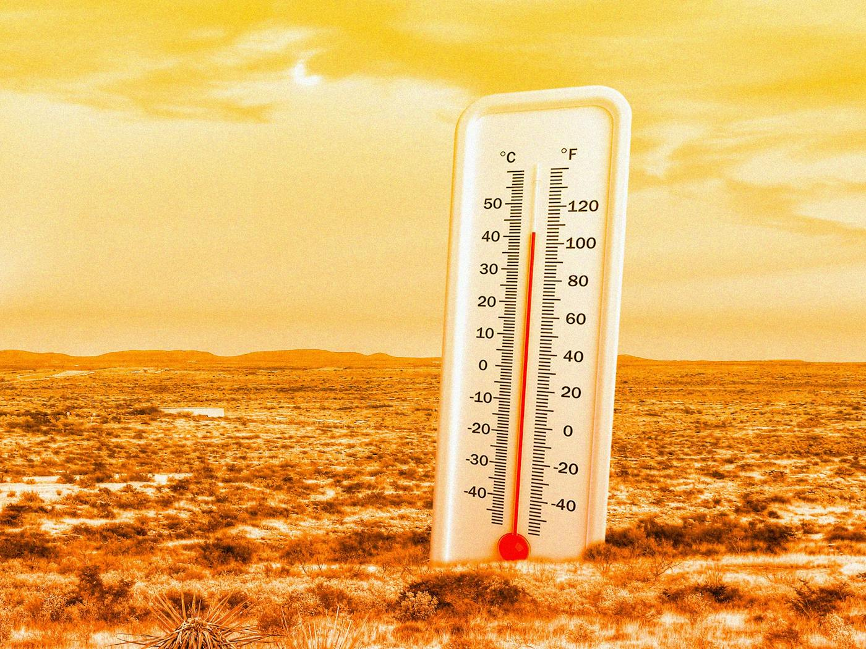
Contributing Factors
Temperature
Humidity
Radiant Heat
Air Velocity
Notes:
Heat Illness most affects those who have not built up a tolerance to the heat (ac·cli·ma·ti·za·tion).
Acclimatization allows us to handle the heat better. The workload for these workers should be gradually increased or they should be allowed more frequent breaks during the first week. Workers might be at greater risk than others if they have not built up a tolerance to hot conditions because they are new to working in hot environments or they have been away from hot working conditions for more than a week. That means that even if the worker has been doing this every summer for many years, there is still an adjustment period when the weather becomes hotter. Everyone is at risk during a heat wave.
OSHA found that acclimatization programs were an integral part of heat illness prevention programs.
OSHA conducted a systematic review of 19 enforcement cases in 2014. 12 were fatalities and the rest were severe heat-related illnesses.
Lack of acclimatization related to severe heat illness or death in was found in 74% of OSHA heat-related 5(a)1 citations from 2012 and 2013.
In addition, lack of heat illness prevention programs in general, but especially the lack of acclimatization, puts workers more at risk for heat-related illness or death.
The focus for this year’s Campaign is getting the word out about acclimatization as an essential element of a comprehensive heat illness prevention program.
Allow workers to get used to hot environments by gradually increasing exposure. New workers and all workers returning from a prolonged absence should begin with 20% of the workload on the first day, increasing incrementally by no more than 20% each subsequent day. During a rapid change in excessively hot weather, even experienced workers should begin on the first day of work in excessive heat with 50% of the normal workload and time spent in the hot environment, 60% on the second day, 80% on day three, and 100% on the fourth day. Full acclimatization may take up to 14 days or longer depending on factors related to the individual or the environment.

Slide 21

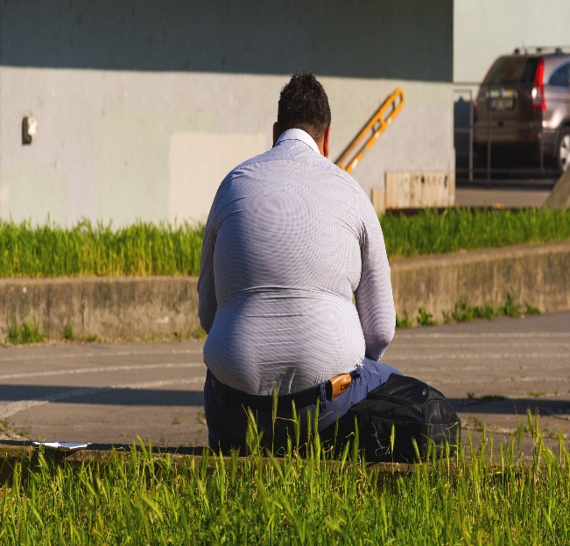
Contributing Factors – Cont’d
Personal Factors
Age
Weight
Fitness
Acclimatization – increased tolerance to heat that comes from working in a hot environment for a period of 1-2 weeks.

Slide 22

Heat Disorders
Heat Rash
Heat Cramps
Heat Exhaustion
Heat Stroke

Slide 23
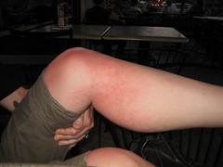
Heat Disorders
  Heat Rash
Also known as “Prickly Heat.”
Occurs when sweat cannot freely evaporate from the skin and sweat ducts become plugged. This inflammation can cause a red rash.
Can be prevented by wearing clothes that allow sweat to evaporate as well as bathing regularly and drying the skin.

Slide 24
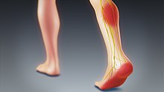
Heat Disorders
Heat Cramps
Cramps in the arms, legs, or abdomen
Occur in individuals who sweat profusely then drink large quantities of water, but do not adequately replace the body’s salt loss
To prevent, ensure that salts are replaced during and after heavy sweating

Slide 25
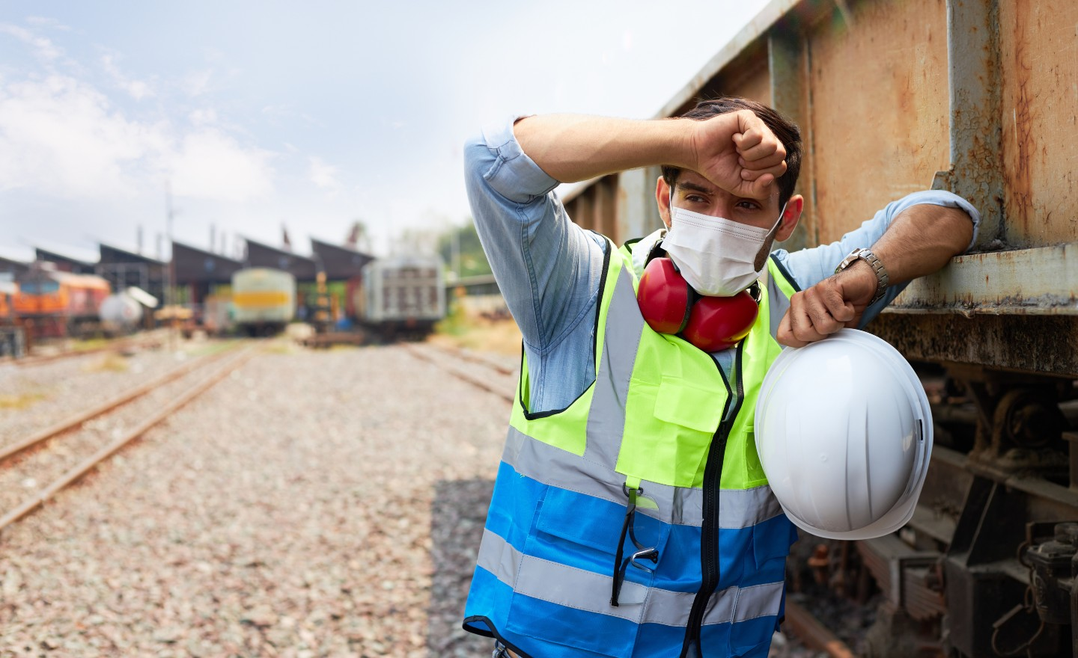
Heat Disorders
Heat Exhaustion – Cause
Mild form of shock caused when the circulatory system begins to fail as a result of the body’s inadequate effort to give off excessive heat.
Although not an immediate threat to life, if not properly treated, could evolve into heat stroke.

Slide 26
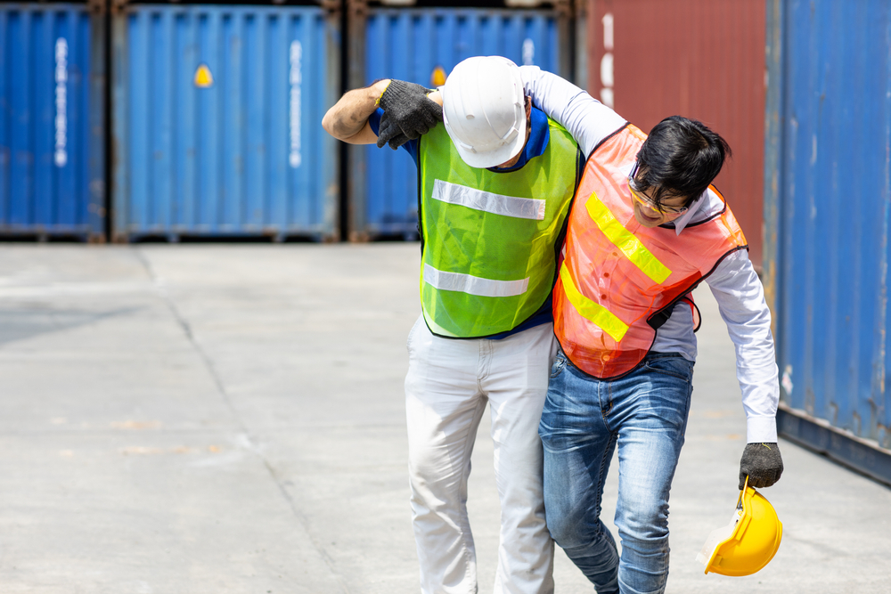
Heat Disorders
Heat Exhaustion – Symptoms
Skin is clammy and moist
Extreme weakness or fatigue
Nausea
Headache
Complexion pale or flushed
Body temperature normal or slightly elevated

Slide 27
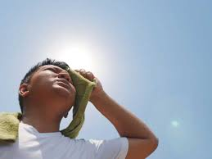
Heat Disorders
Heat Exhaustion - Treatment
Do not leave the person alone
Move to a cool place to rest
Drink water or electrolyte fluids
Treat for shock, if necessary
If unconscious, fails to recover rapidly, has other injuries, or has a history of medical problems, seek medical attention

Slide 28
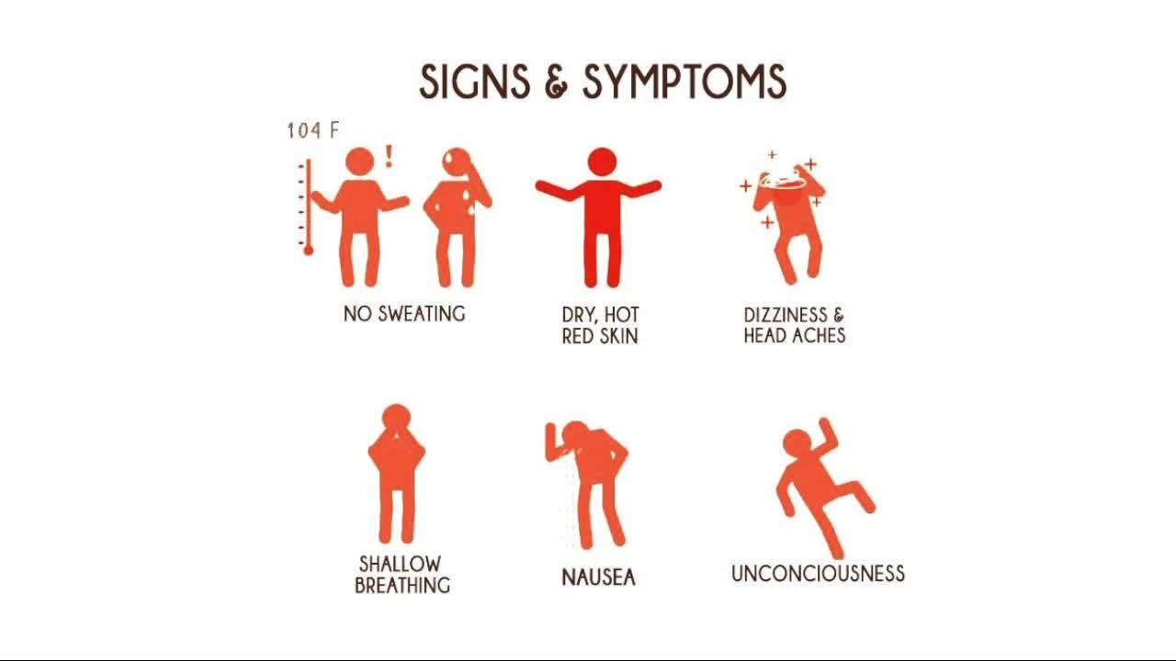
Heat Disorders
Heat Stroke – Symptoms
Stop Sweating
Rapid Pulse
Mental Confusion
Loss of Consciousness
Convulsions
Body Temperature > 105
Hot, dry skin
Can die unless treated promptly

Slide 29
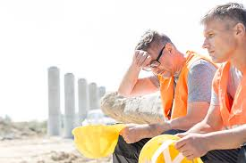
Heat Disorders
Heat Stroke - Cause
Severe and sometimes fatal condition resulting from the failure of the body to regulate its core temperature.
The body’s normal cooling mechanisms stop functioning, sweating stops.
True medical emergency requiring immediate medical attention.

Slide 30
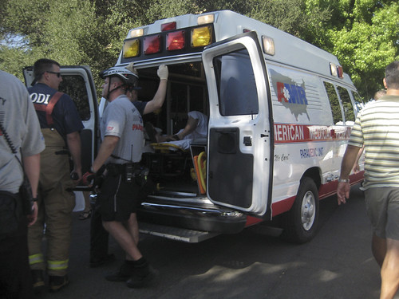
Heat Disorders
Heat Stroke – Treatment
Call 911
Remove victim to a cool area
Soak clothing with cool water and fan vigorously to increase cooling
Monitor vital signs

Slide 31
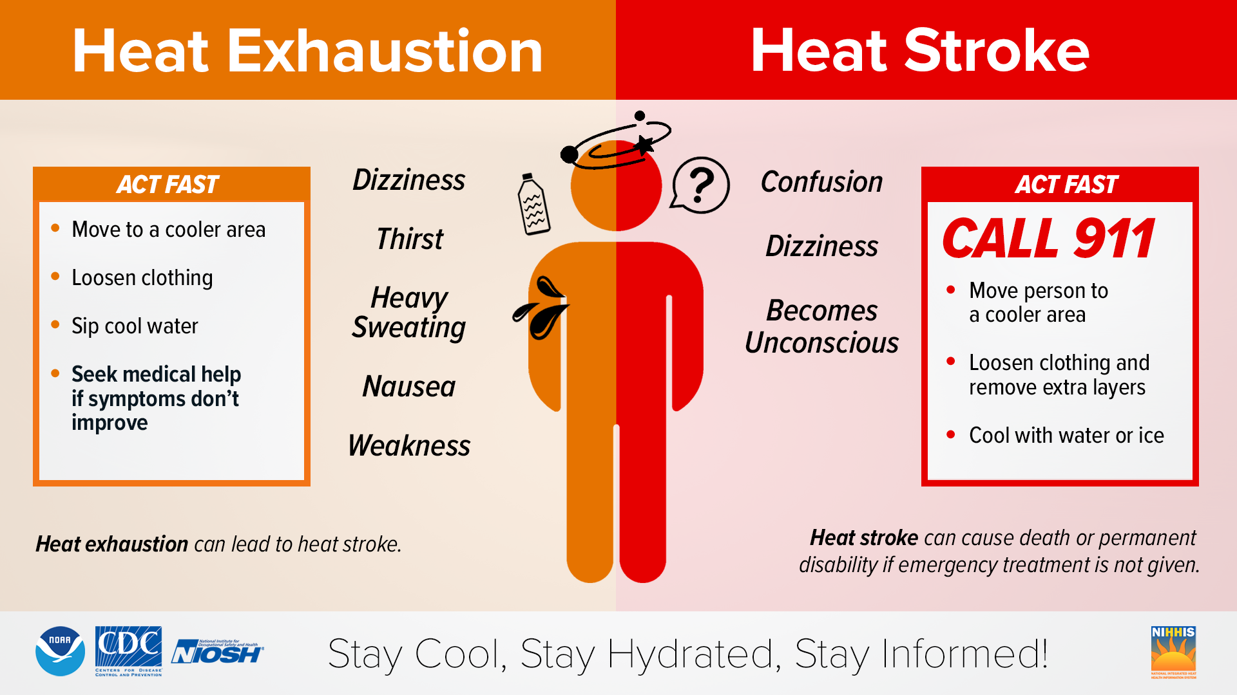
Take Action!!

Slide 32
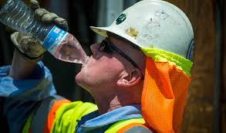
Prevention Methods
In Hot Weather: NIOSH recommends drinking about one cup (8 ounces) of water every 15-20 minutes. For jobs lasting two hours or more, also consider electrolyte-containing beverages like sports drinks to replenish lost electrolytes. Do not drink more than 48 ounces (1.5 quarts) of water per hour.
Don't Overdo It: Drinking too much water can cause hyponatremia (low sodium levels in the blood), which can be a medical emergency. NIOSH recommends not drinking more than 48 ounces of water per hour.
Listen to Your Body (But Don't Rely on Thirst): While you should drink fluids when you are thirsty, it's best to drink before you feel thirsty, as thirst can be a sign of dehydration. You should be encouraged to drink at regular intervals throughout the work day, not just when you feel thirsty.

Slide 33
Prevention Methods
Acclimatization: Gradual acclimatization to hot environments can improve your body's tolerance to heat.
Cool Down Breaks: Take frequent breaks in shaded or air-conditioned areas.
Monitor Coworkers: Observe your coworkers for signs of heat-related illness and offer assistance if needed.
Eat Regular Meals: Eating regular meals and snacks can help replace lost electrolytes.
Work In Pairs: The Buddy System allows for workers to look after one another
Proper Scheduling: Try to adjust the most strenuous work during the coolest times of the day.

Slide 34
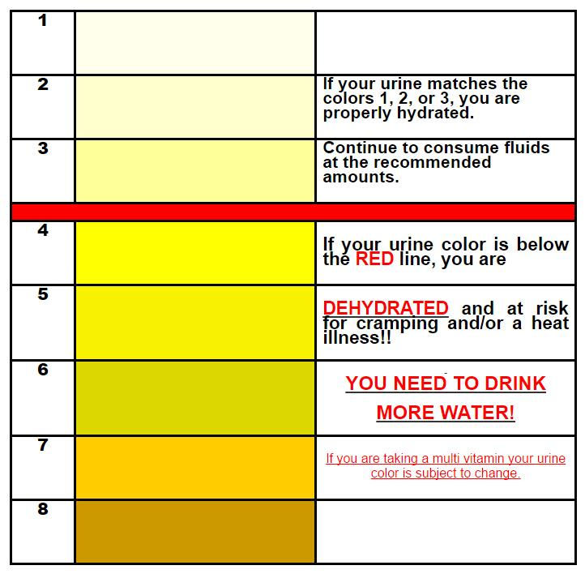
Are You Hydrating Enough
Urine Color Chart
The following Dehydration Urine Color Chart will help you use your urine color as an indicator of your level of dehydration and what actions you should take to help return your body back to a normal level of hydration.
If your urine color is 4-5, you should drink a little water (1/4 liter) over the next hour or two
If your urine color is 6-7, you should drink ¼ liter of water right now.
If your urine is 8 or darker, drink two bottles of water right now. If your urine is darker than this and /or brown or red, then dehydration may not be your problem. Please consult your doctor.

Slide 35
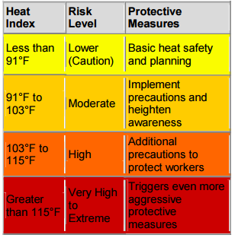
Heat Guideline
Be familiar with the heat index and what corresponding steps to take.
Use a heat stress thermometer.
Provide potable water supply with Gatorade packets.
Identify a cool area to retreat to.
Consider external cooling devices
Ex: Cooling bandanas, vests, etc.

Slide 36
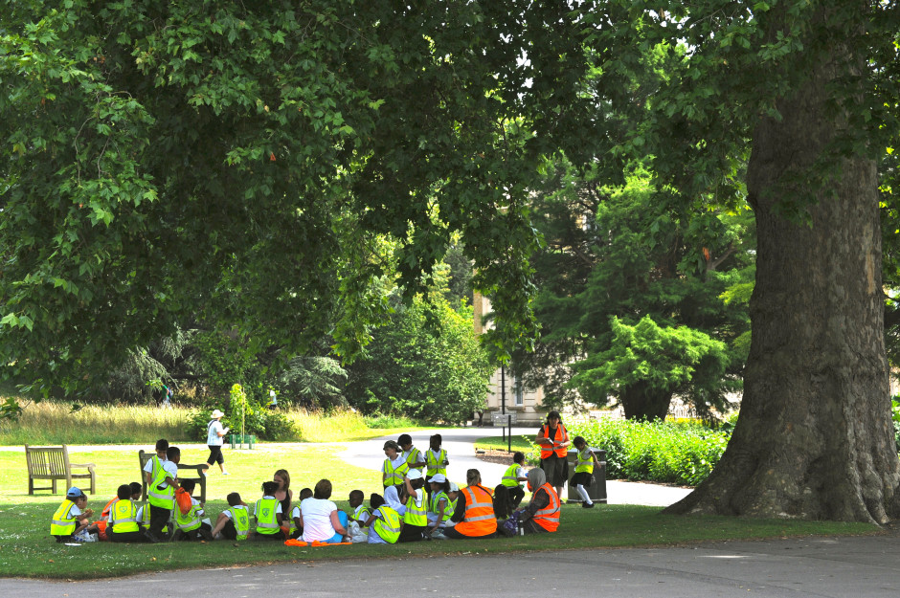
Prevention Methods
Spend as little time as possible in direct sunlight
Take frequent breaks in cool, shaded areas
Wear light, loose fitting, clothing
Avoid caffeine, which can make the body lose water
Rotate workers in and out of hot areas if possible

Slide 37
Conclusion
Preventing heat-related illnesses is not only a regulatory requirement—it’s a responsibility we have to protect the health and lives of our workers. By understanding the warning signs of heat disorders, implementing proactive prevention strategies, and fostering a culture of situational awareness and hydration, we can significantly reduce the risk of heat stress incidents on the job.
Stay Alert, Stay Cool, and Look Out for One Another—because safety doesn’t take a break, even when the temperature rises.

Slide 38
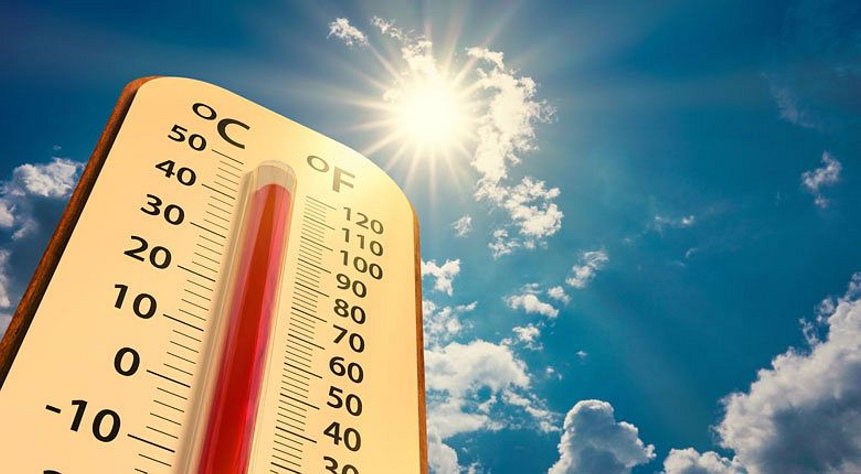
?
ANY QUESTIONS
OR COMMENTS

Slide 39

LET’S RAFFLE!

Slide 40
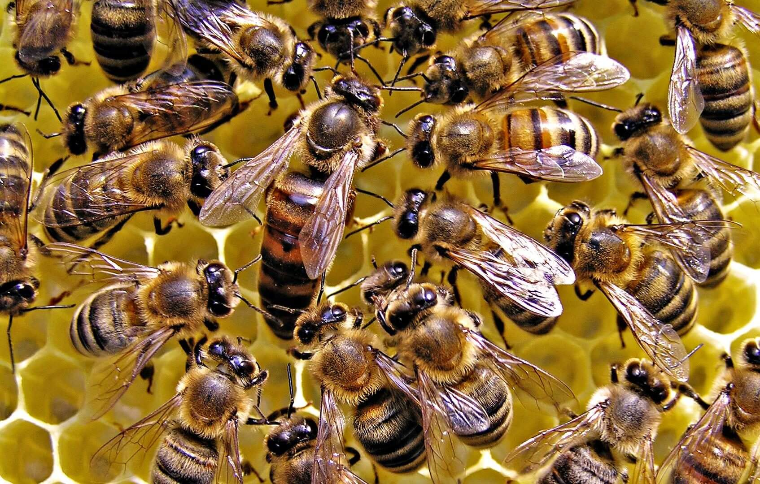
Stinging Insects

Slide 41
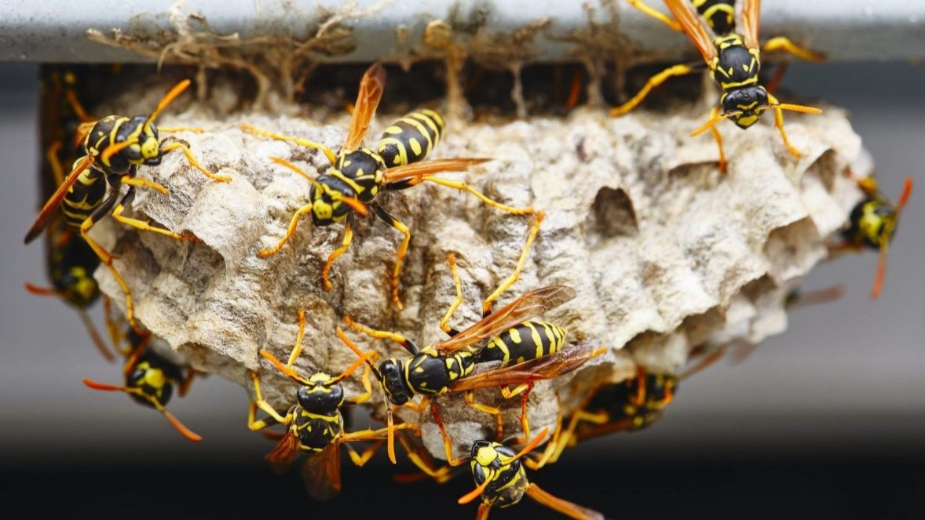
Insects and Scorpions at Work
Key points
Stinging or biting insects or scorpions can be hazardous to outdoor workers.
Stinging or biting insects include bees, wasps, hornets, and fire ants.
Employers and workers can take steps to prevent bites and stings
A sting or bite from insects or scorpions can cause mild discomfort or pain. Workers allergic to the insect’s venom could die from anaphylactic shock. Anaphylactic shock is a severe allergic reaction and requires immediate emergency care.
Workers with a history of severe allergic reactions to insect bites or stings should carry an EpiPen and wear a medical identification bracelet or necklace.

Slide 42
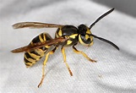
Bees, Wasps, and Hornets
Bees, wasps, and hornets are most abundant in the warmer months. Nests and hives may be found in trees, under roof eaves, or on equipment such as ladders.
Bees, wasps, and hornets are found throughout the United States.
Worker Protections:
Wear light-colored, smooth-finished clothing
Avoid perfumed soaps, shampoos, and deodorants
  Don't wear cologne or perfume
  Avoid bananas and banana-scented toiletries
Wear clean clothing and bathe daily, as sweat may anger bees
Wear clothing to cover as much of the body as possible
Avoid flowering plants when possible
Keep work areas clean. Social wasps thrive in places where humans discard food
Remain calm and still if a single stinging insect is flying around. Swatting at an insect may cause it to sting

Slide 43
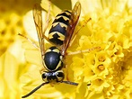
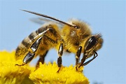
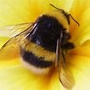
Bees, Wasps, and Hornets
Worker Protections (cont.)
If you are attacked by several stinging insects at once, run to get away from them. Bees release a chemical when they sting, which may attract other bees.
Go indoors
A shaded area is better than an open area to get away from insects
Do not jump into water since some insects will hover above water
If a bee comes inside your vehicle, stop the car slowly, and open all the windows.

Slide 44

Bees, Wasps, and Hornets
First Aid
If a worker is stung by a bee, wasp, or hornet:
Have someone stay with them to see if they have an allergic reaction
Wash the site with soap and water
Remove the stinger
  Wipe gauze or scrape a fingernail over the area
  Never squeeze the stinger or use tweezers
Apply ice to reduce swelling
Do not scratch the sting
  Scratching may increase swelling, itching, and risk of infection

Slide 45
Fire Ants
Fire ants bite and sting. They are aggressive when stinging and inject venom, which causes a burning sensation. Red bumps form at the sting, and within a day or two they become white fluid-filled pustules.
Fire ants are mostly found in the Southeastern United States, with limited geographic distribution in New Mexico, Arizona, and California.
Worker Protections
Do not disturb or stand on or near ant mounds.
Be careful when lifting items (including animal carcasses) off the ground, as they may be covered in ants.
Fire ants may also be found on trees or in water, so always look over the area before starting to work.

Slide 46
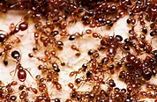
Fire Ants
First Aid
If a worker is stung or bitten by fire ants:
Rub off ants briskly, as they will attach to the skin with their jaws
Antihistamines may help
  Follow directions on the package
  Drowsiness may occur.
Take them to an emergency medical facility immediately if they have:
  Severe chest pain
  Nausea
  Severe sweating
  Loss of breath
  Serious swelling
  Slurred speech

Slide 47

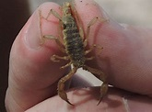

Scorpions
Scorpions usually hide during the day and are active at night. They may be hiding under rocks, wood, or anything else lying on the ground. Some species may also burrow into the ground. Most scorpions live in dry, desert areas. However, some species can be found in grasslands, forests, and inside caves.
Scorpions are found in the Southern and Southwestern United States.

Slide 48
Scorpions
Symptoms
Symptoms of a scorpion sting may include:
  Stinging or burning at the sting site (very little swelling or inflammation)
  Positive "tap test" (extreme pain when the sting site is tapped with a finger)
  Restlessness
  Convulsions
  Roving eyes
  Staggering gait
  Thick tongue sensation and/or slurred speech
  Drooling
  Muscle twitches
  Abdominal pain and cramps
  Trouble breathing
These symptoms usually subside within 48 hours, although stings from a bark scorpion can be life-threatening.

Slide 49

Scorpions
Worker Protections
Wear long sleeves and pants.
Wear leather gloves.
Shake out clothing or shoes before putting them on.
First Aid
If a worker is stung by a scorpion:
  Contact a qualified health care provider or poison control center.
  Apply ice, but do not submerge the affected area in ice water.
  Remain relaxed and calm.
  Do not take any sedatives.
  Capture the scorpion for identification if it is safe to do so

Slide 50
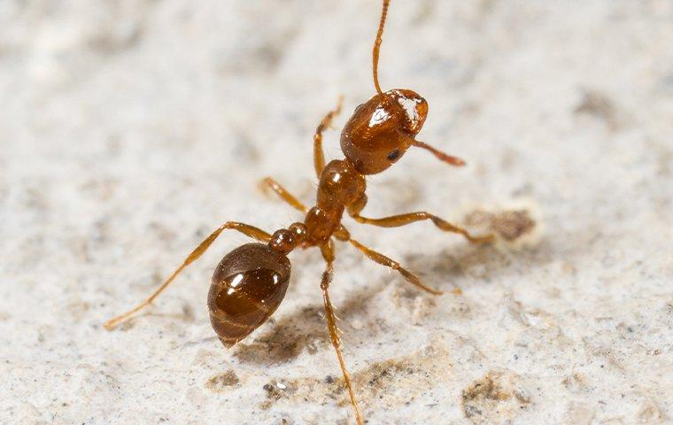
?
ANY QUESTIONS
OR COMMENTS

Slide 51

LET’S RAFFLE!

Slide 52
SAFETY REVIEW
FRANK SAVAGE

Slide 53
INCIDENTS & NEAR MISSES
At approximately 8:15 PM on 5/15/2025, a pump panel arc-flashed and a fire resulted. There were two electricians working on the lower section of the pump panel, the electricians were working on the 120 volts side of the pump panel box because it would only run in hand and not on auto. While the electricians were checking out the HOA switch the upper portion of the pump panel had a catastrophic failure and the pump box arc flashed. One electrician was on his knees leaning close to the lower right portion of the panel and the second electrician was standing behind him. The two employees suffered sunburn, and the tips of their hair were burnt. The electricians were mostly shaken up from the incident. The well was shut in and an investigation was started.
After further investigation, it was determined that there was a catastrophic failure in the B Phase of the disconnecting means in the pump panel box. This caused an arc flash and fire. The panel box was sent back to the manufacturer for further investigation on the catastrophic failure.

Slide 54
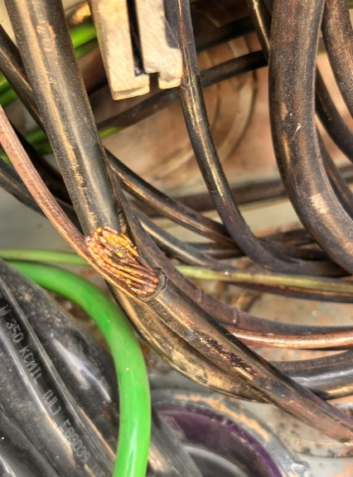
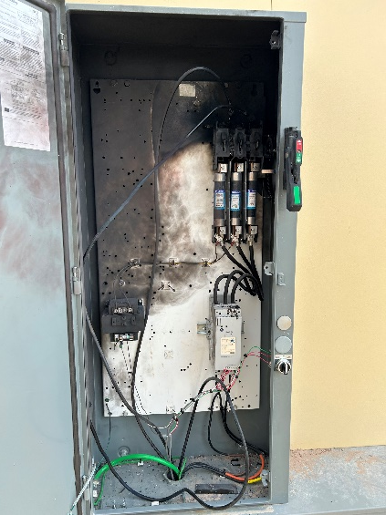
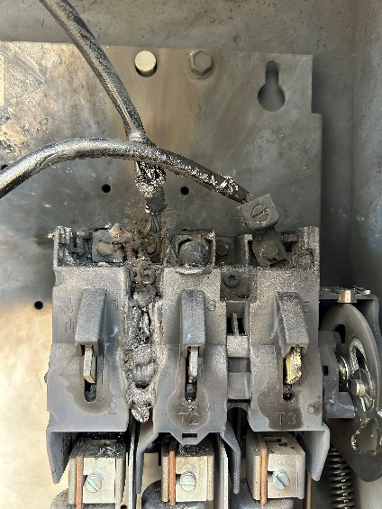
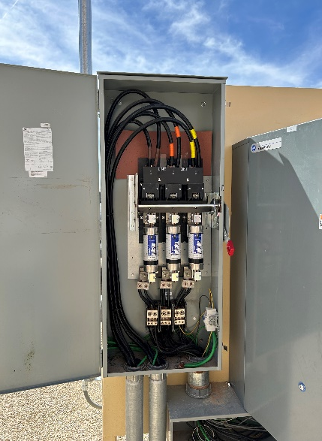
INCIDENTS & NEAR MISSES
Area the electricians were working
Loose Wire,
Heated ends
After further investigation, it was determined that there was a catastrophic failure in the B Phase of the disconnecting means in the pump panel box. This caused an arc flash and fire. The panel box was sent back to the manufacturer for further investigation on the catastrophic failure.

Slide 55
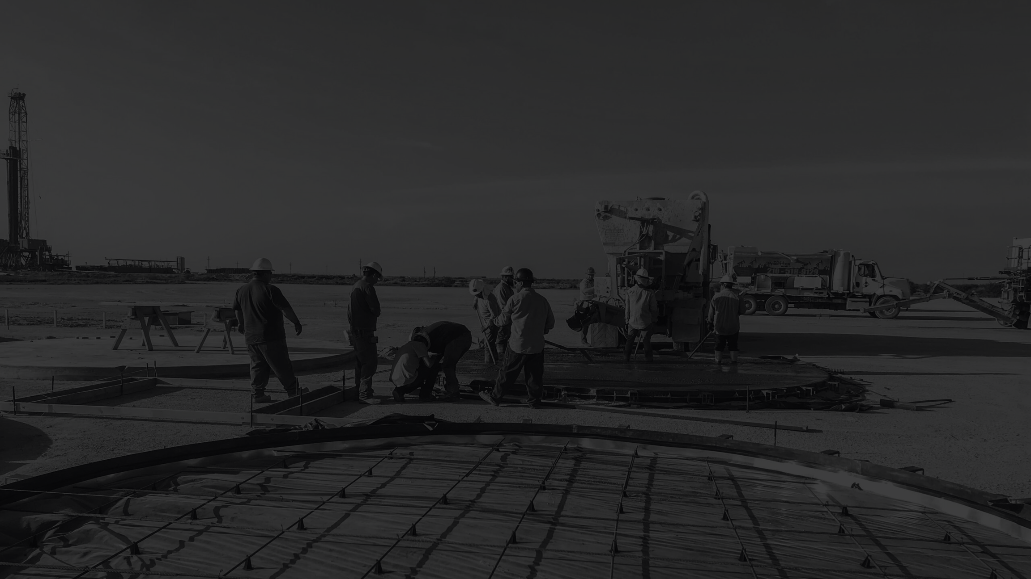
?
ANY QUESTIONS
OR COMMENTS

Slide 56

LOOKING FOR “VOLUNTEERS”
August Contractor Safety MEETING
OPEN TO SUGGESTIONS FOR TOPICS

Slide 57
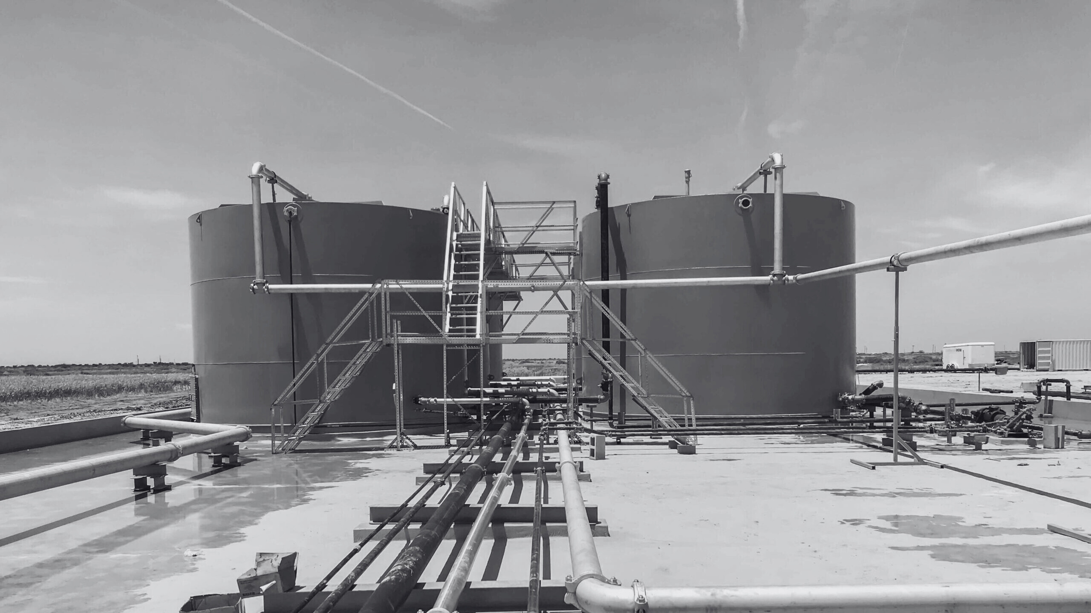
BRUCE JOHNSON
CEO - EnXL

Slide 58

LET’S RAFFLE!

Slide 59
STAY SAFE!
THANK YOU FOR ATTENDING OUR Q2 CONTRACTOR SAFETY MEETING!
Next Company Safety Meeting:
August 28, 2025

